Slide 1
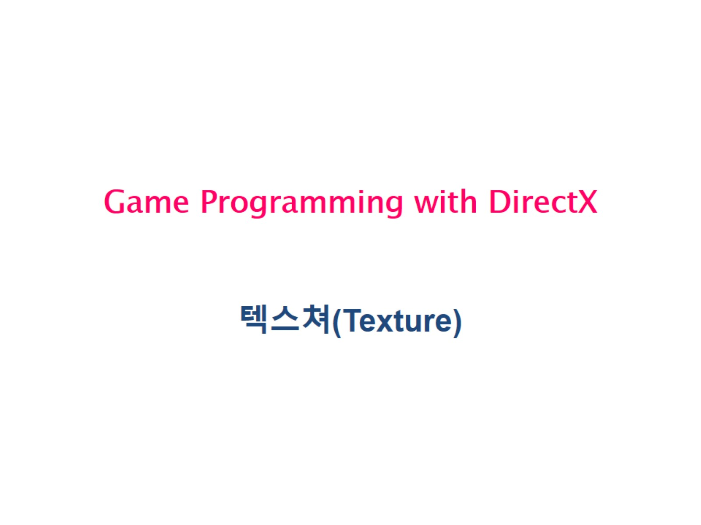
Game Programming with DirectX

Slide 2
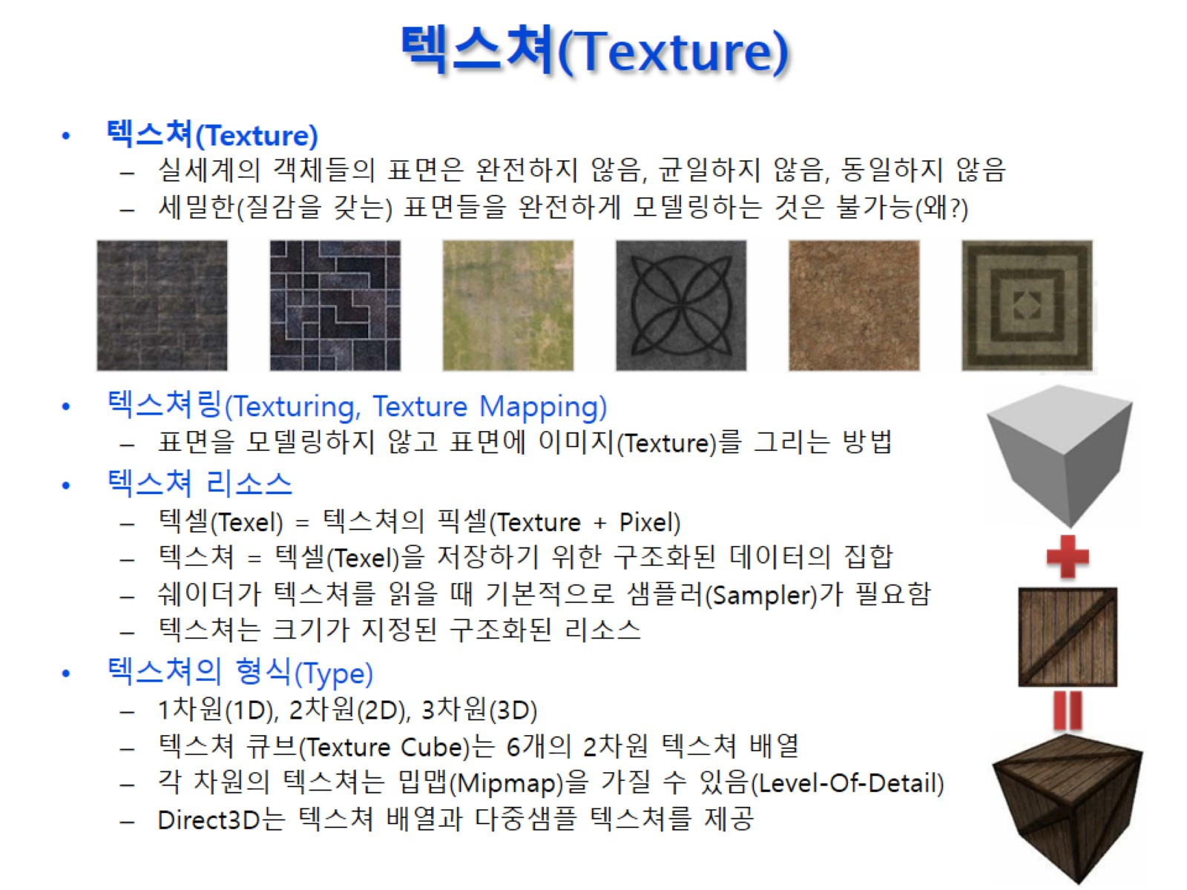
텍스쳐(Texture)

Slide 3
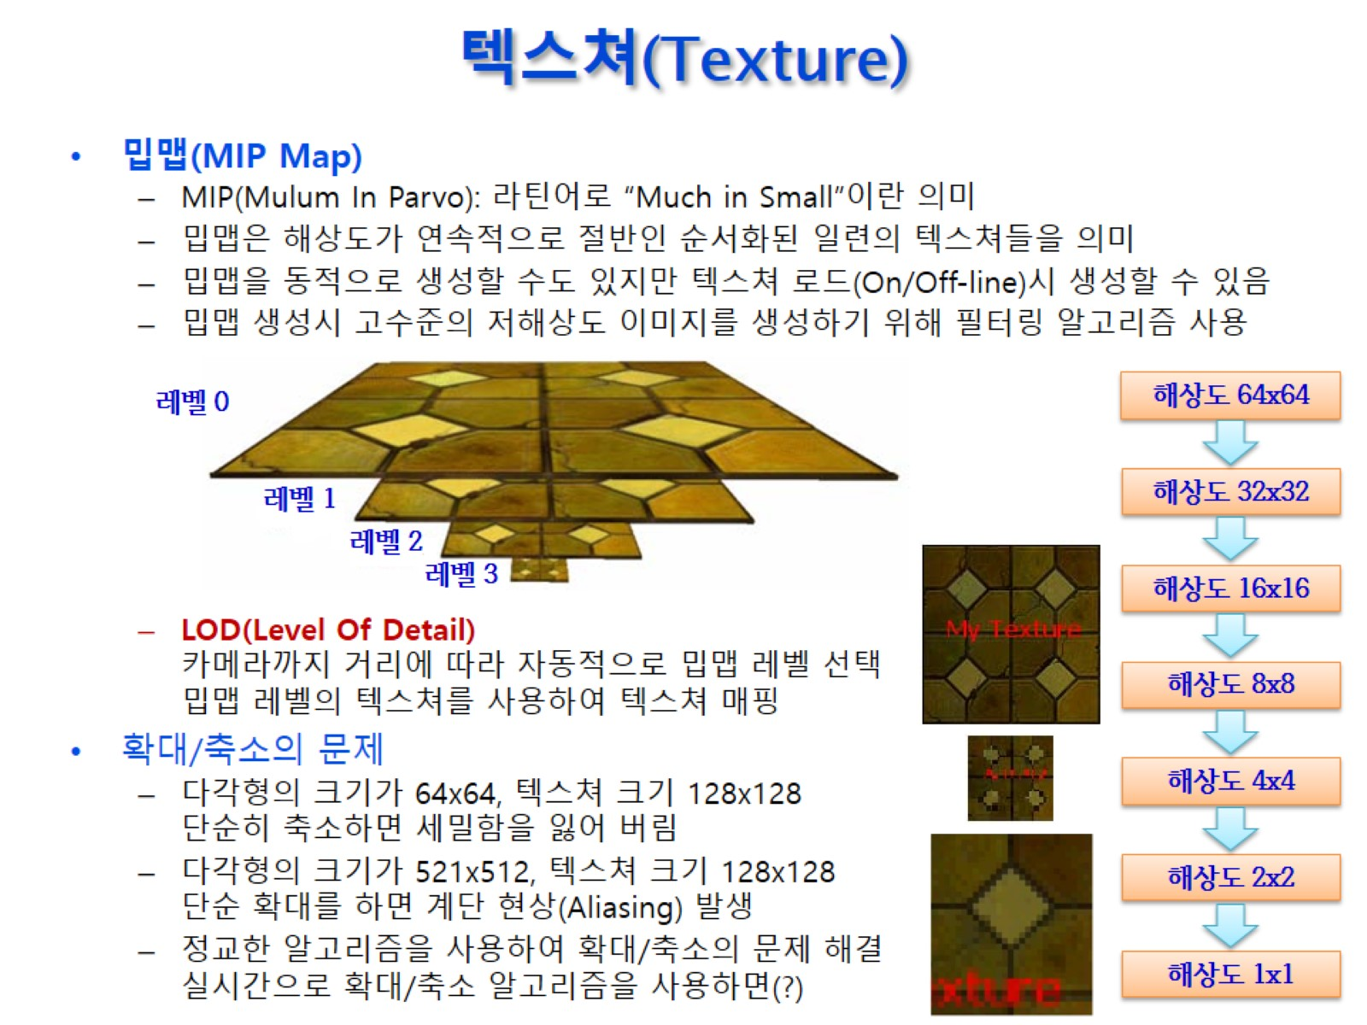
텍스쳐(Texture)

Slide 4
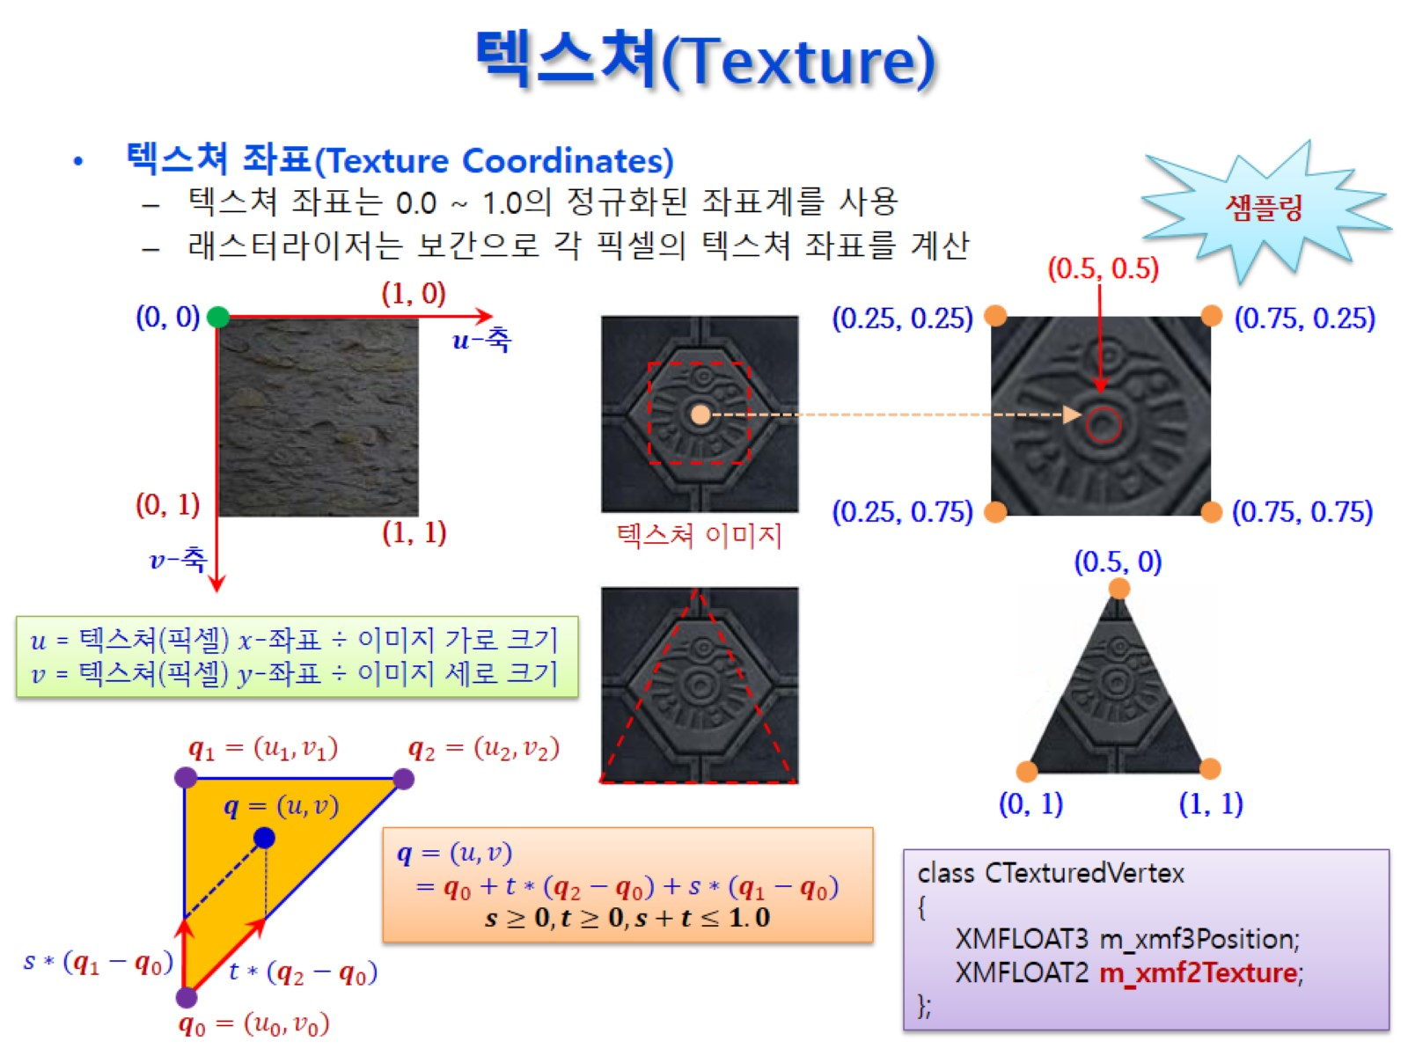
텍스쳐(Texture)

Slide 5
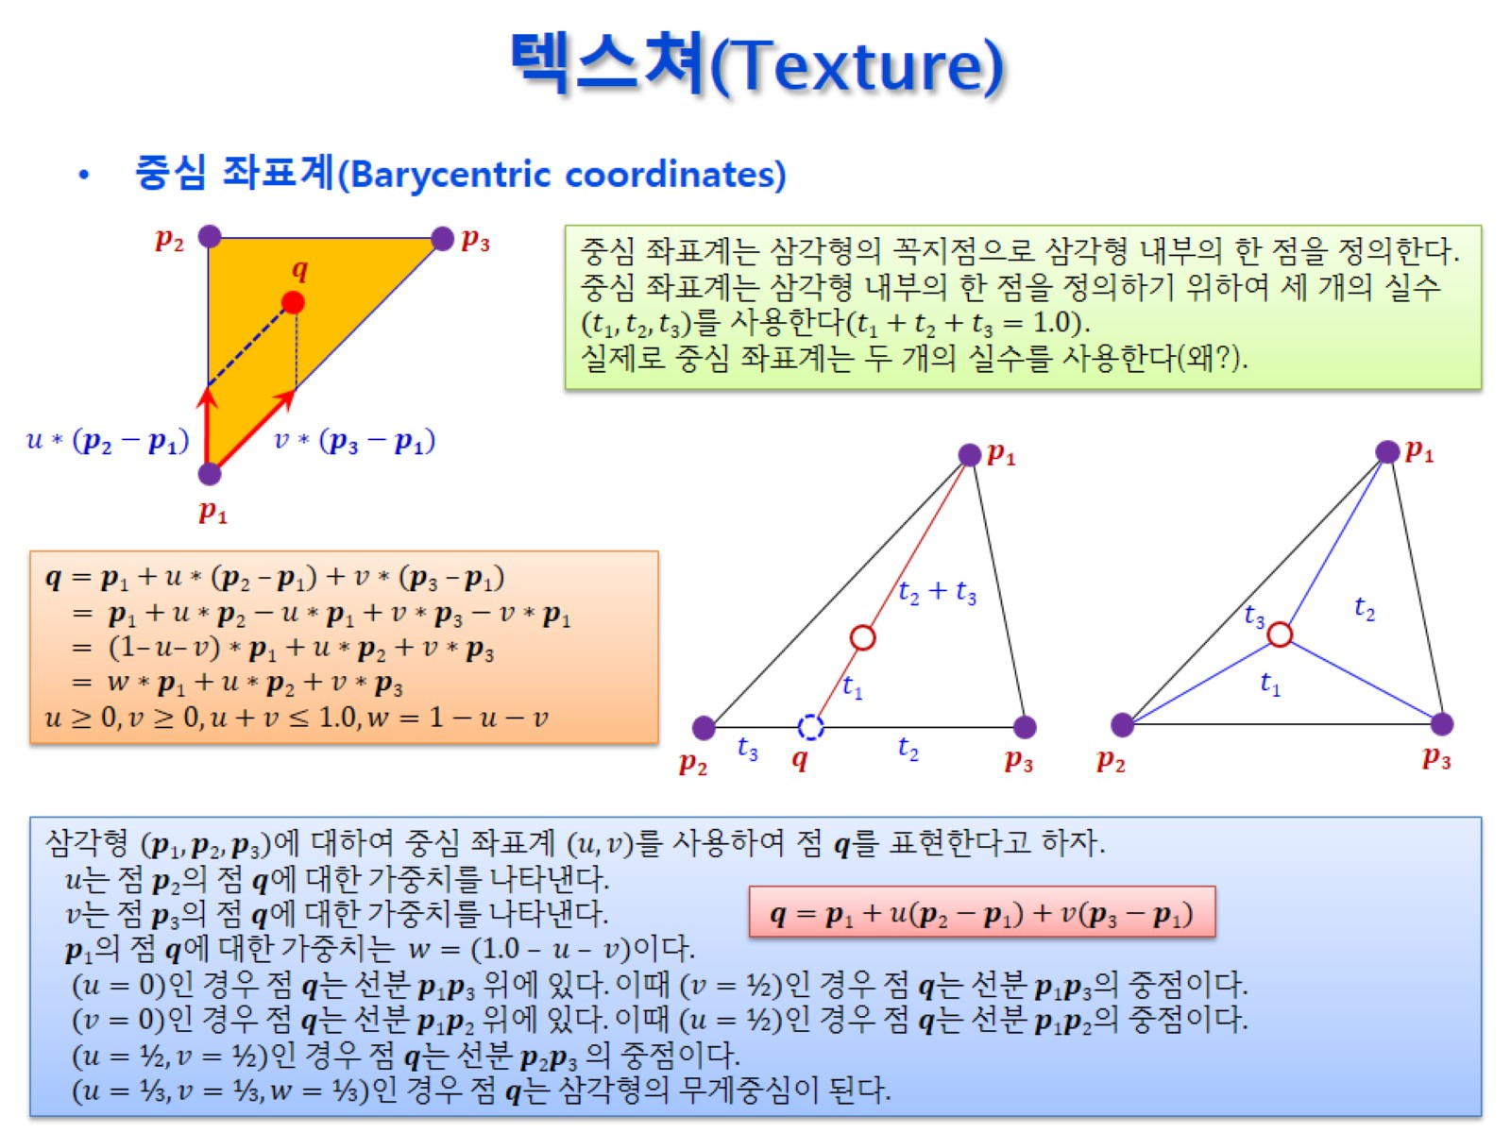
텍스쳐(Texture)

Slide 6
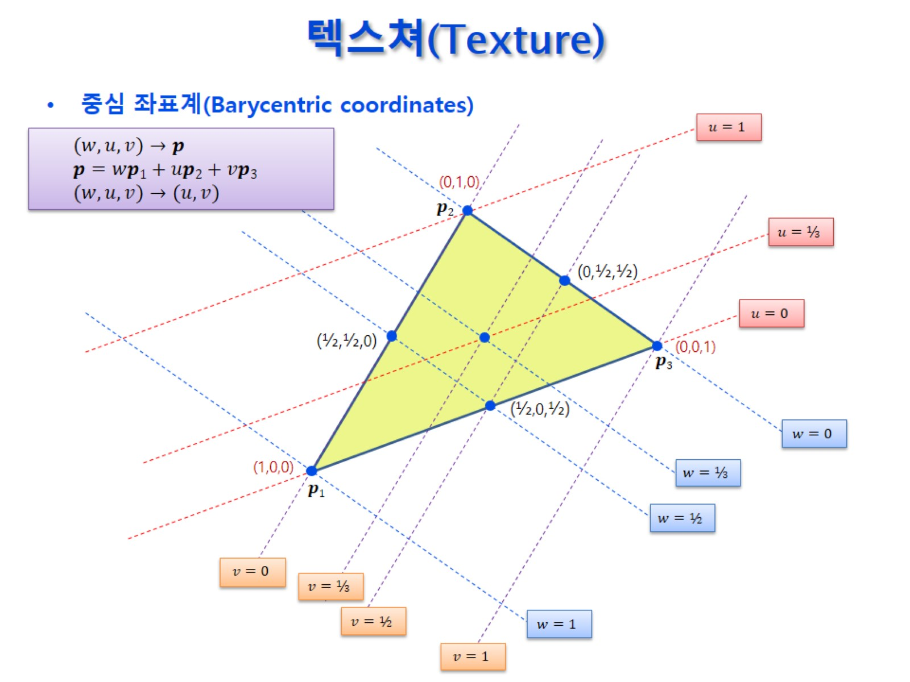
텍스쳐(Texture)

Slide 7
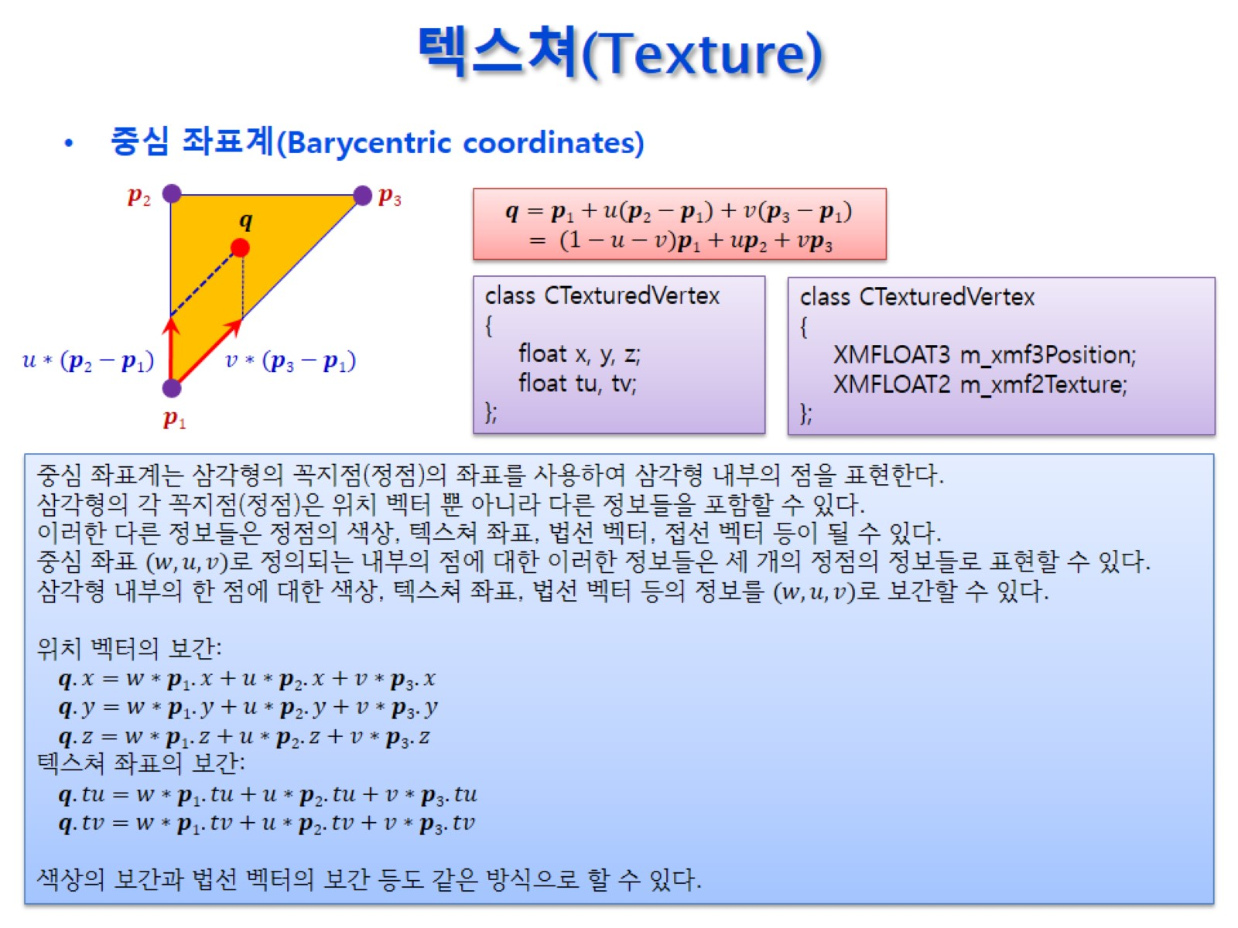
텍스쳐(Texture)

Slide 8
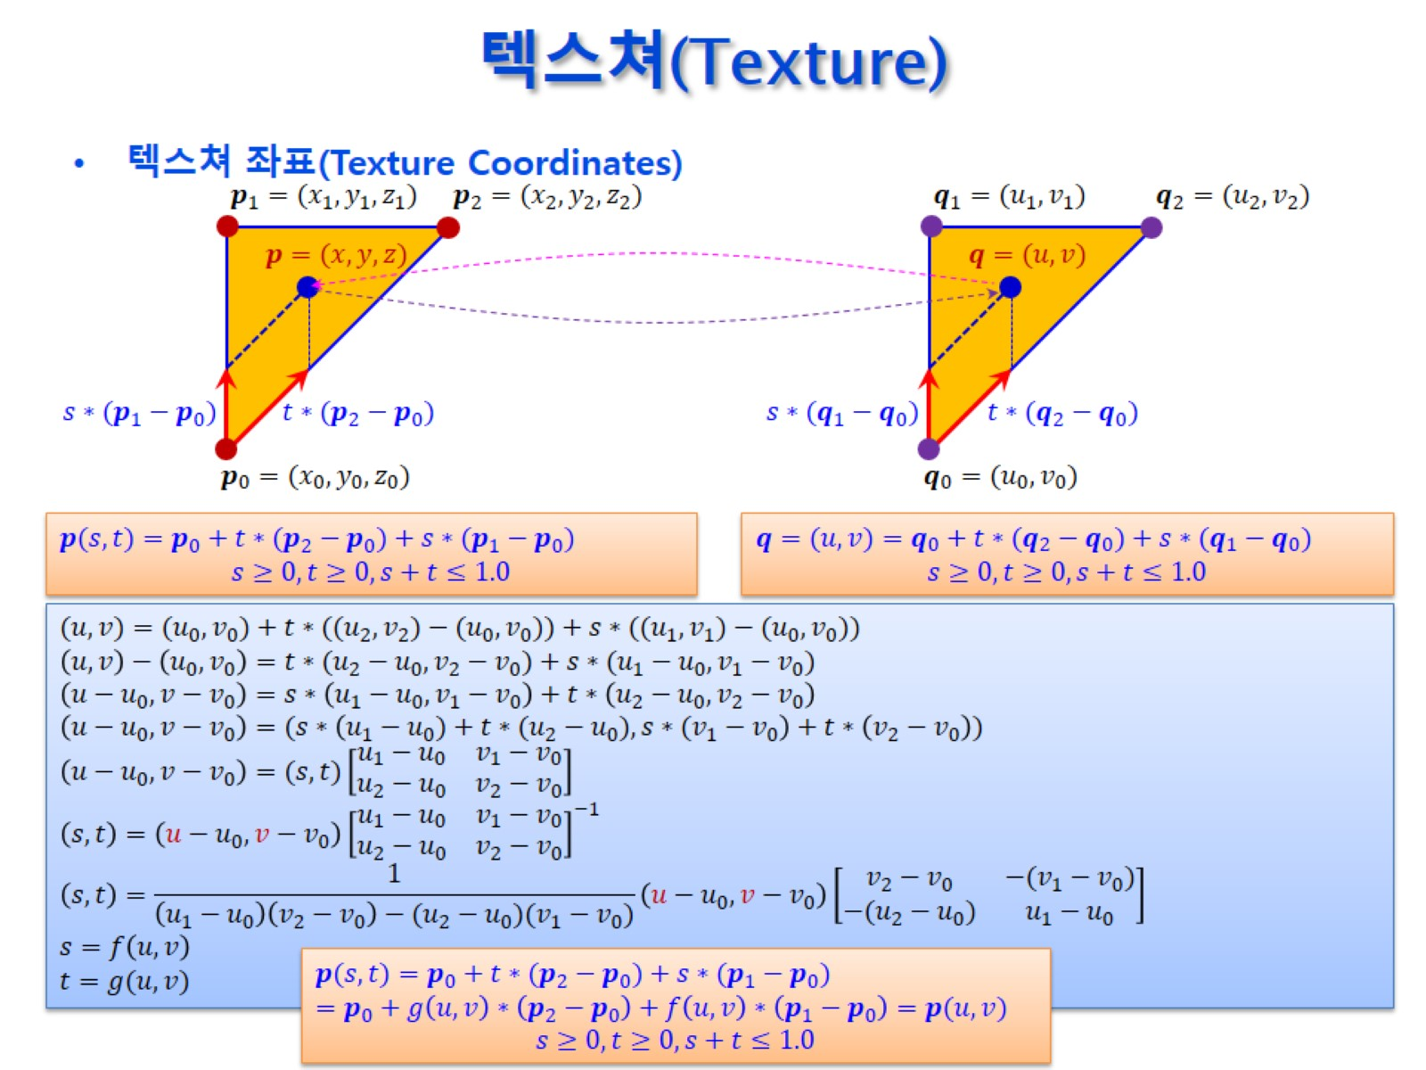
텍스쳐(Texture)

Slide 9
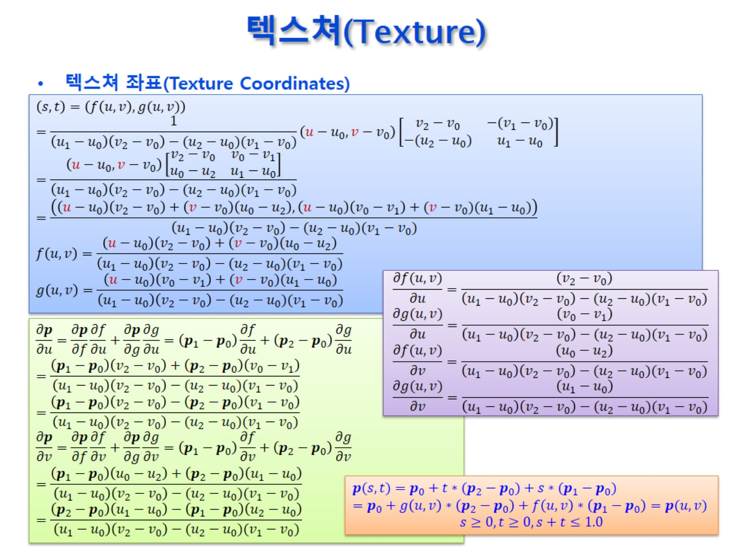
텍스쳐(Texture)

Slide 10
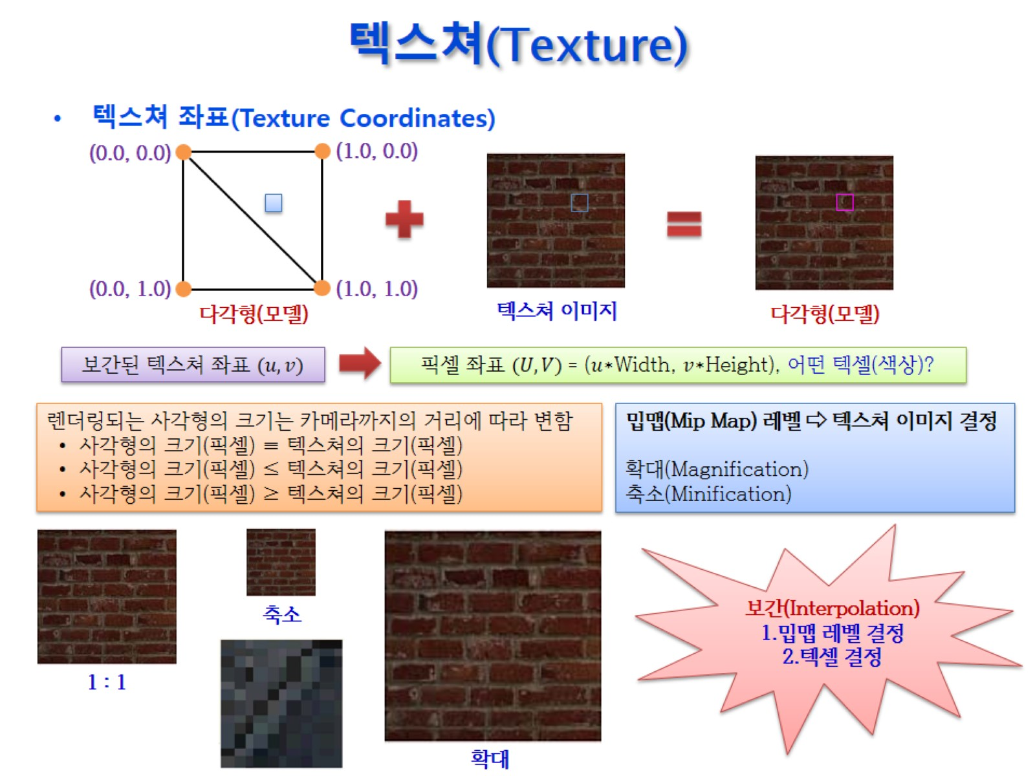
텍스쳐(Texture)

Slide 11
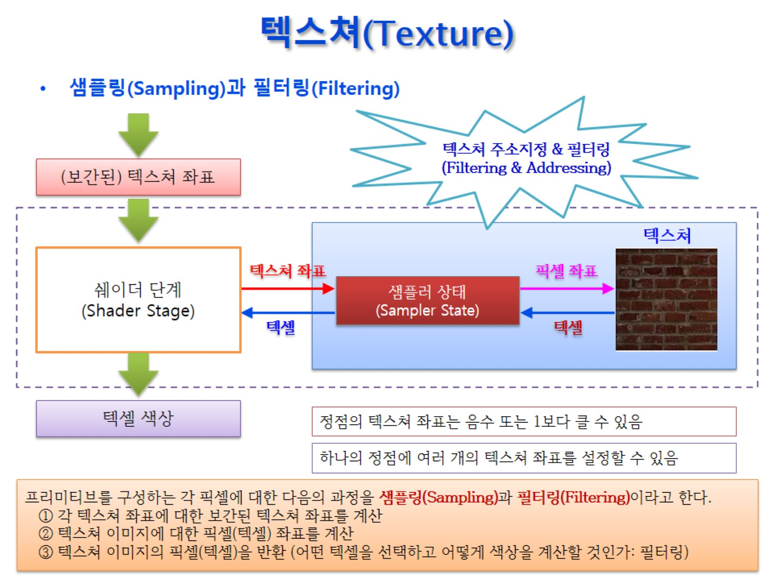
텍스쳐(Texture)

Slide 12
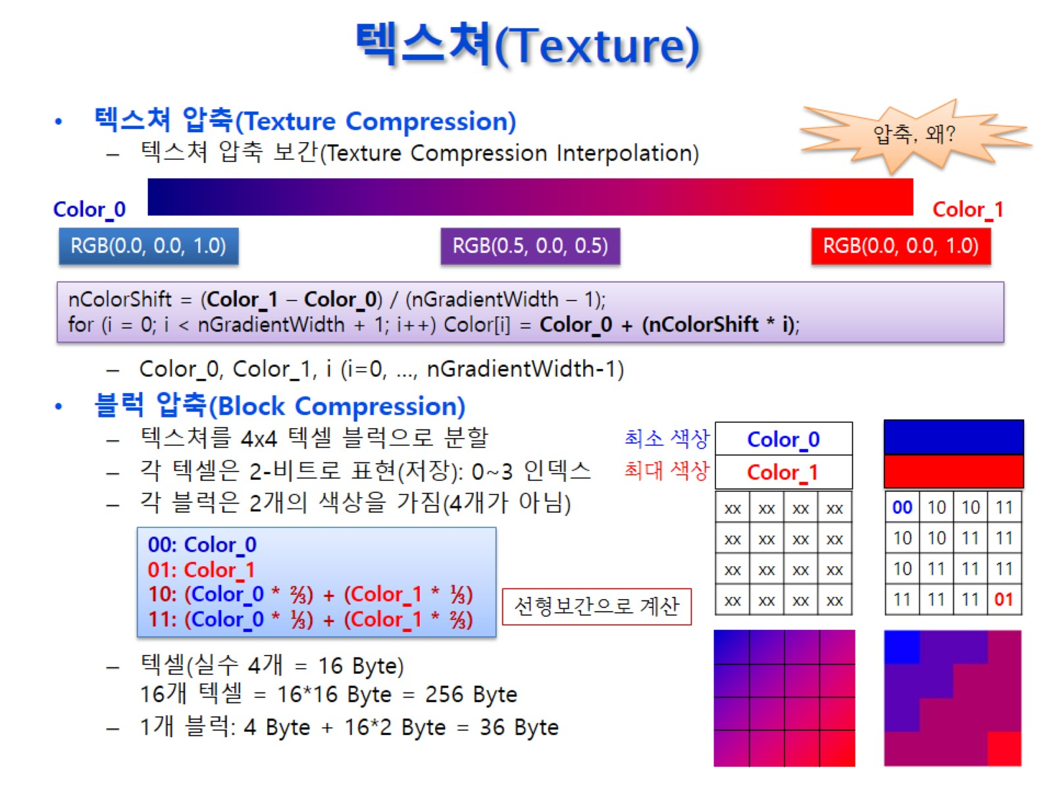
텍스쳐(Texture)

Slide 13
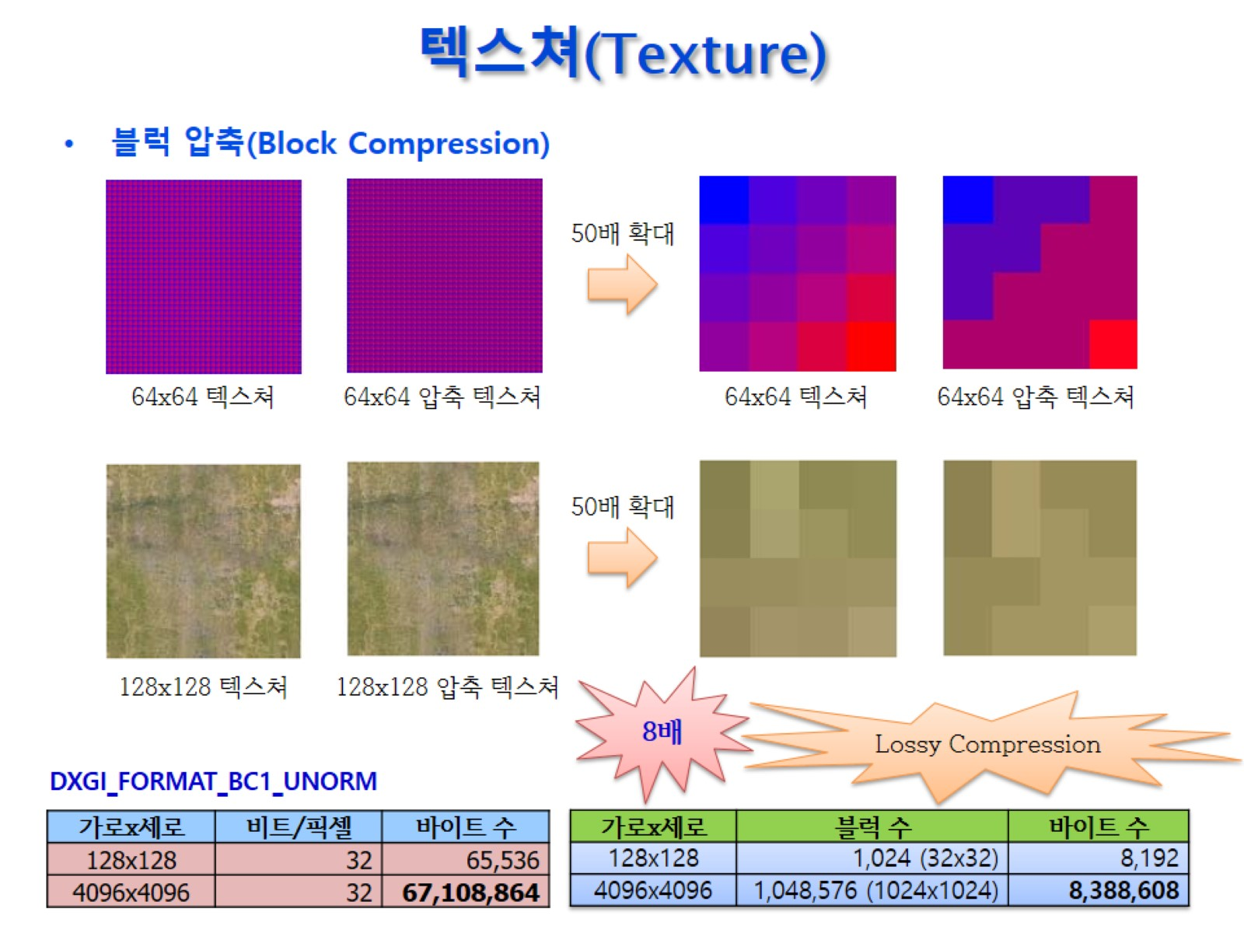
텍스쳐(Texture)

Slide 14
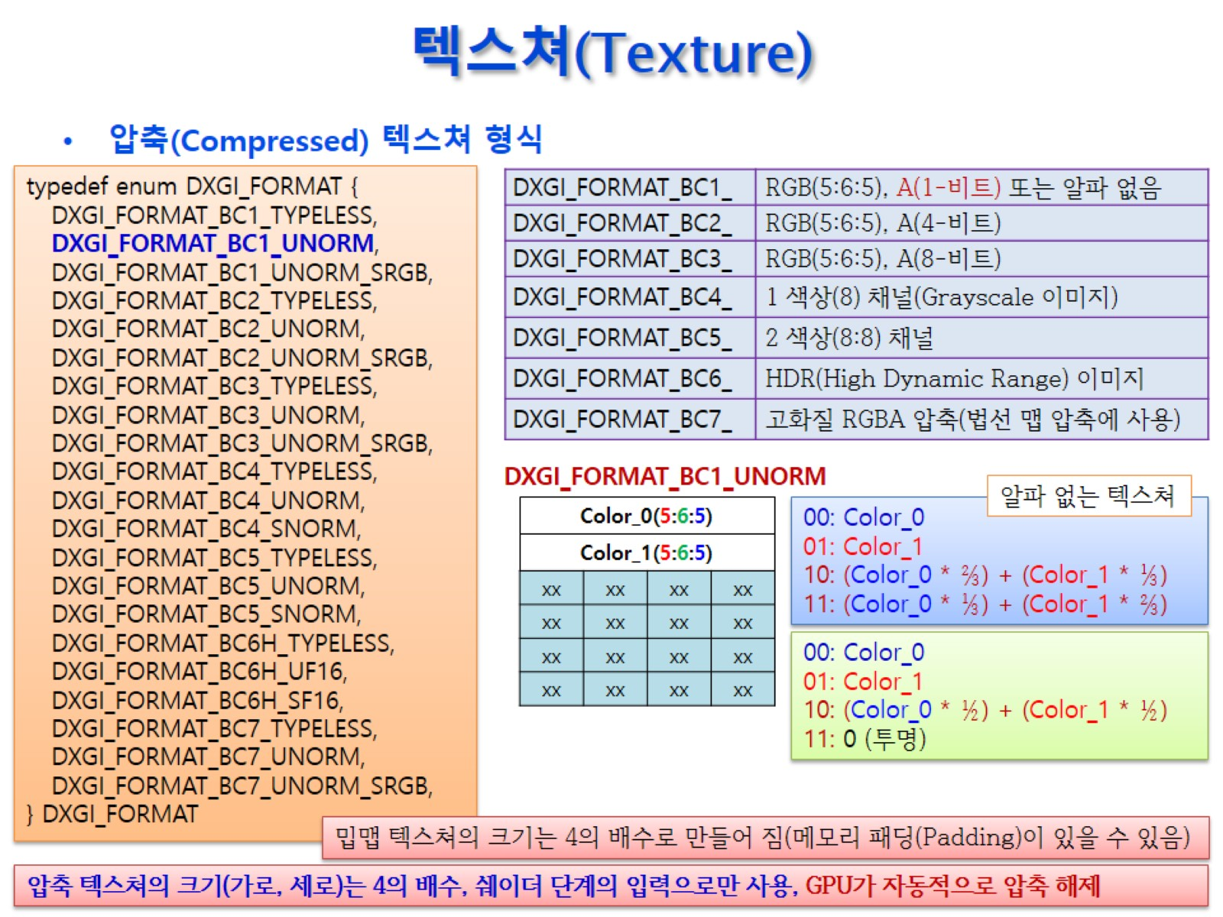
텍스쳐(Texture)

Slide 15
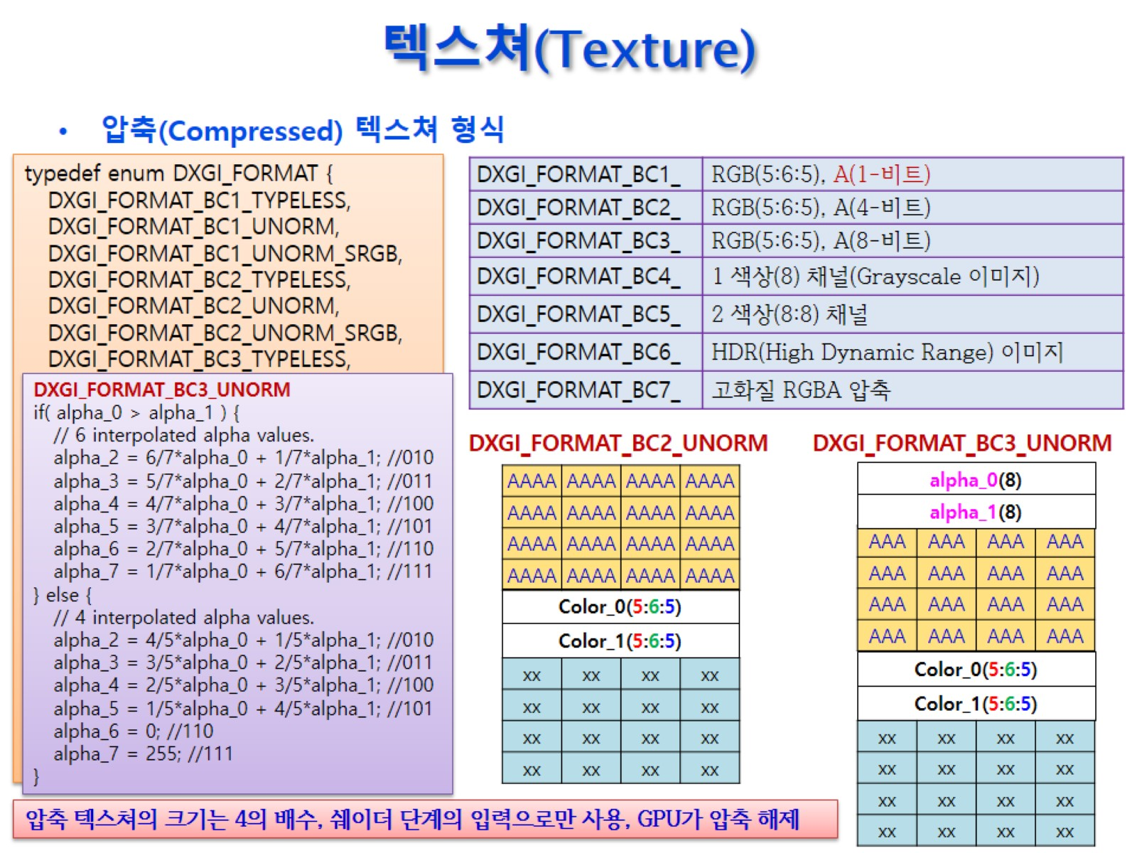
텍스쳐(Texture)

Slide 16
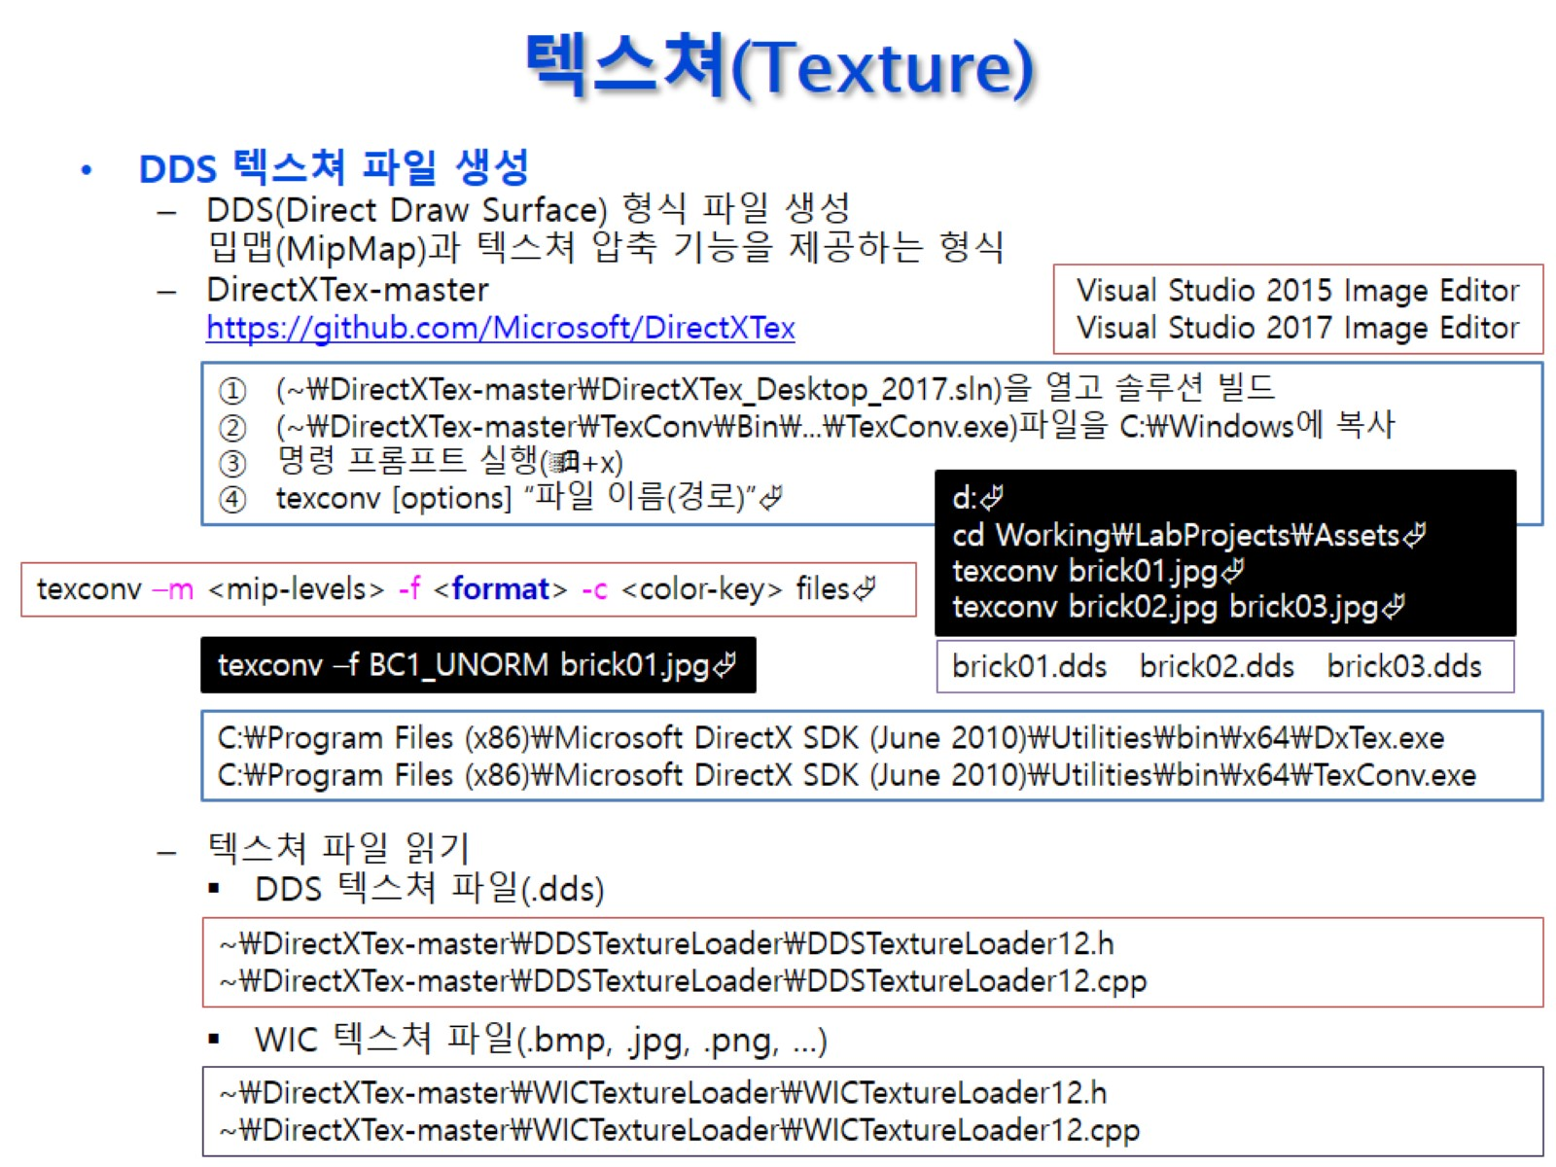
텍스쳐(Texture)

Slide 17
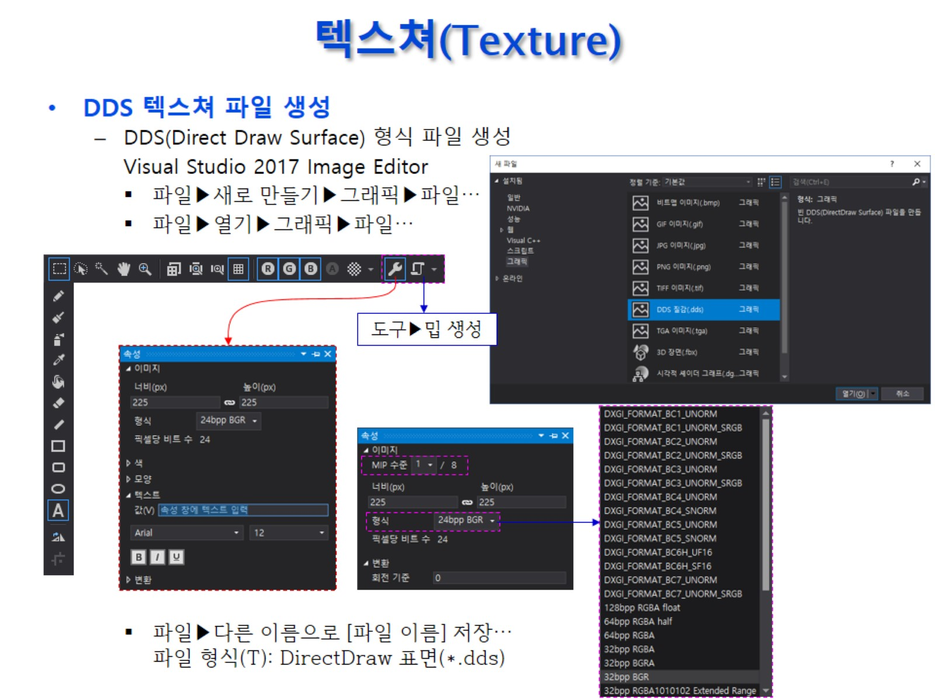
텍스쳐(Texture)

Slide 18
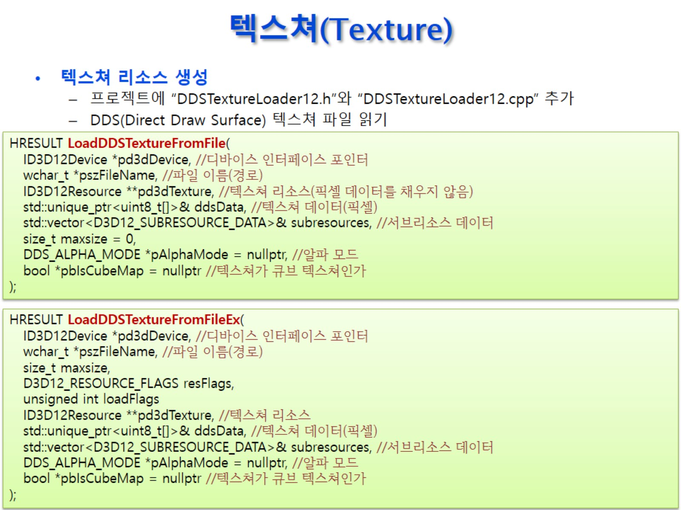
텍스쳐(Texture)

Slide 19
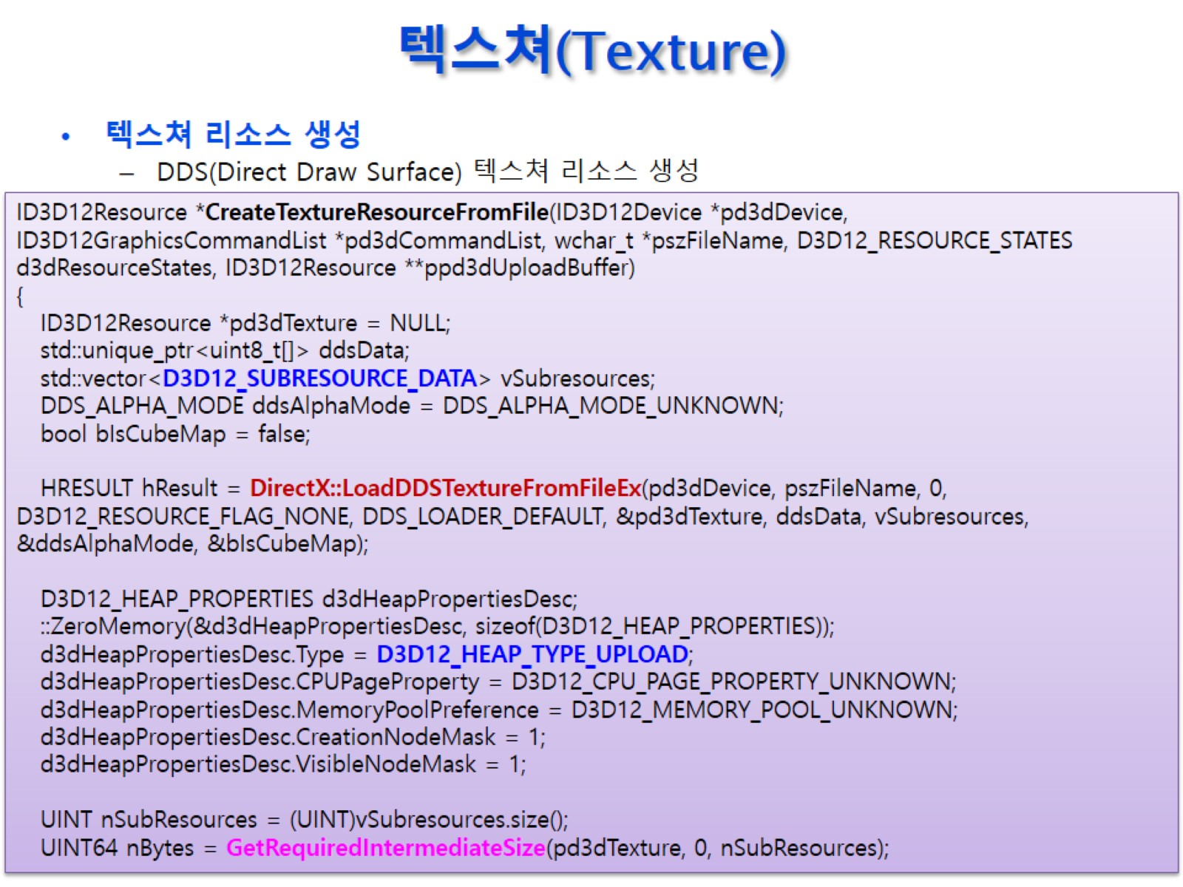
텍스쳐(Texture)

Slide 20
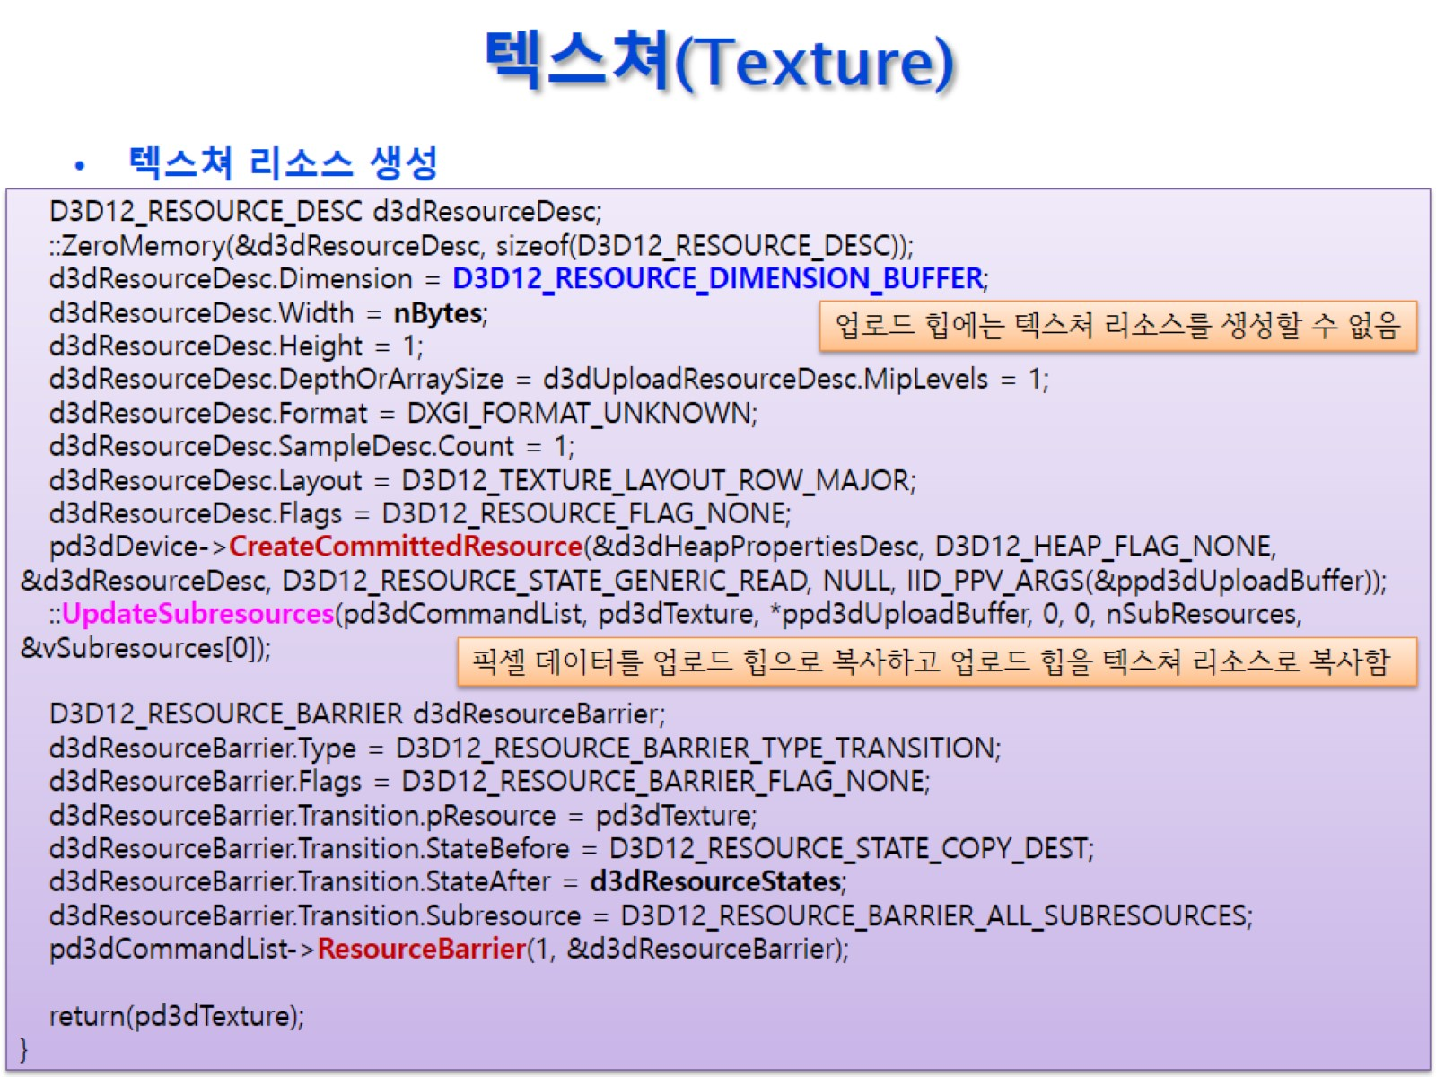
텍스쳐(Texture)

Slide 21
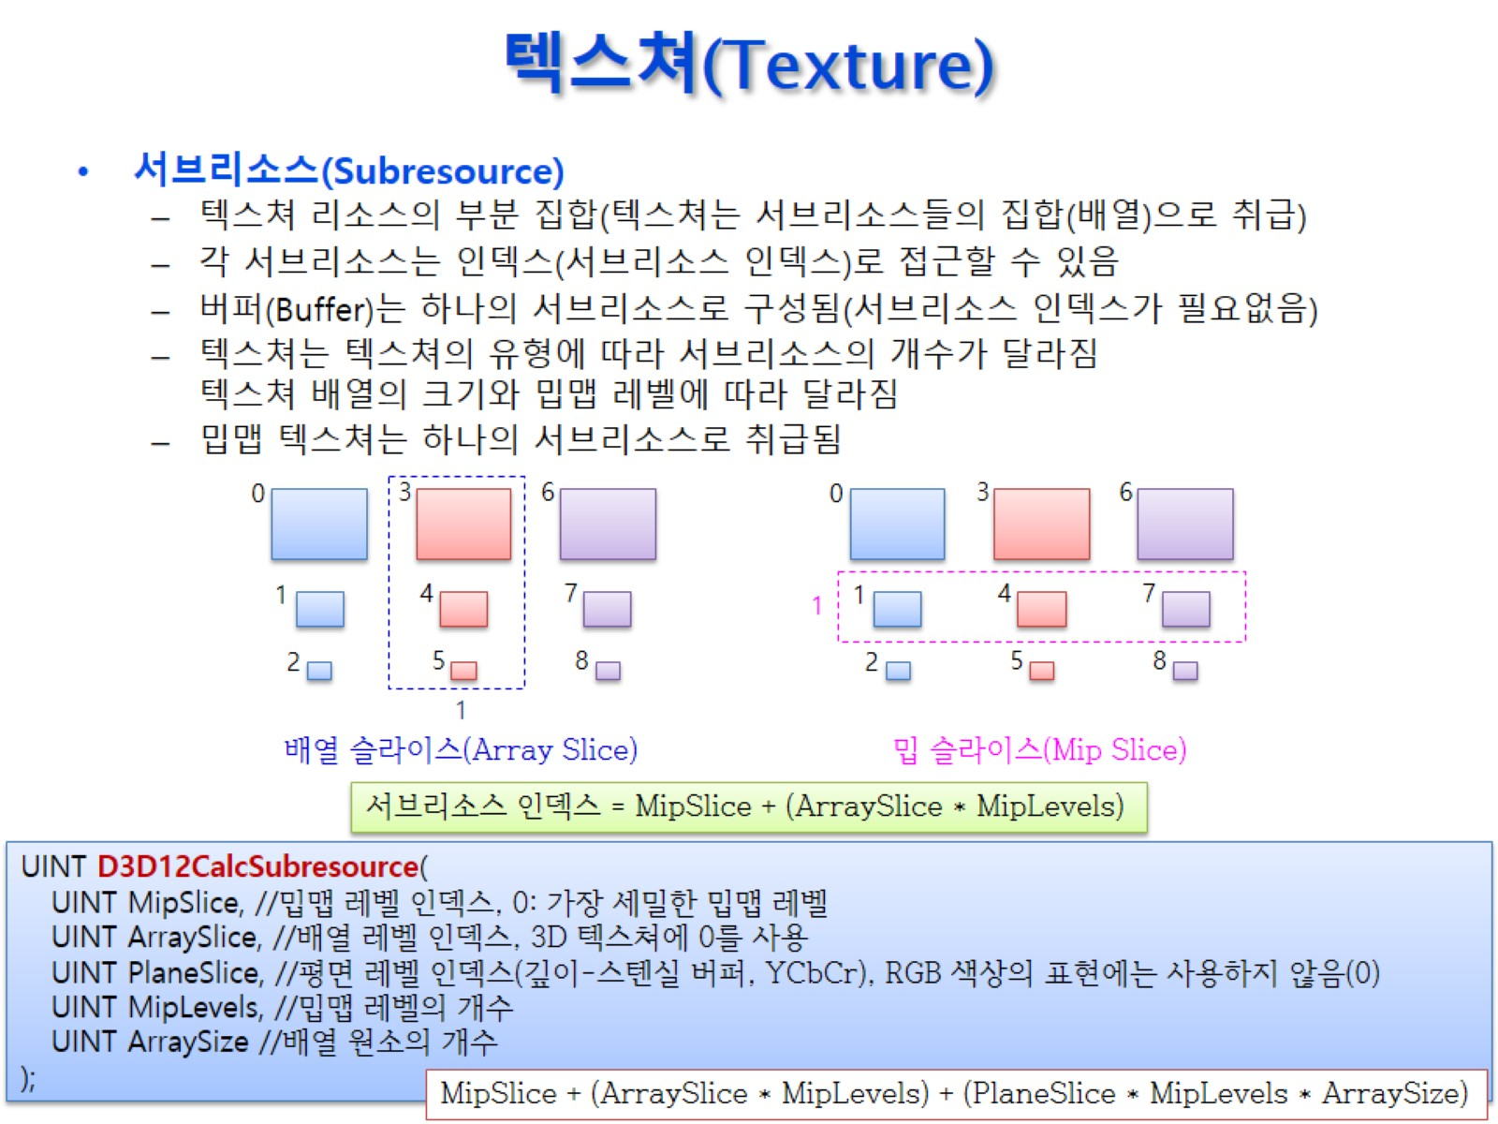
텍스쳐(Texture)

Slide 22
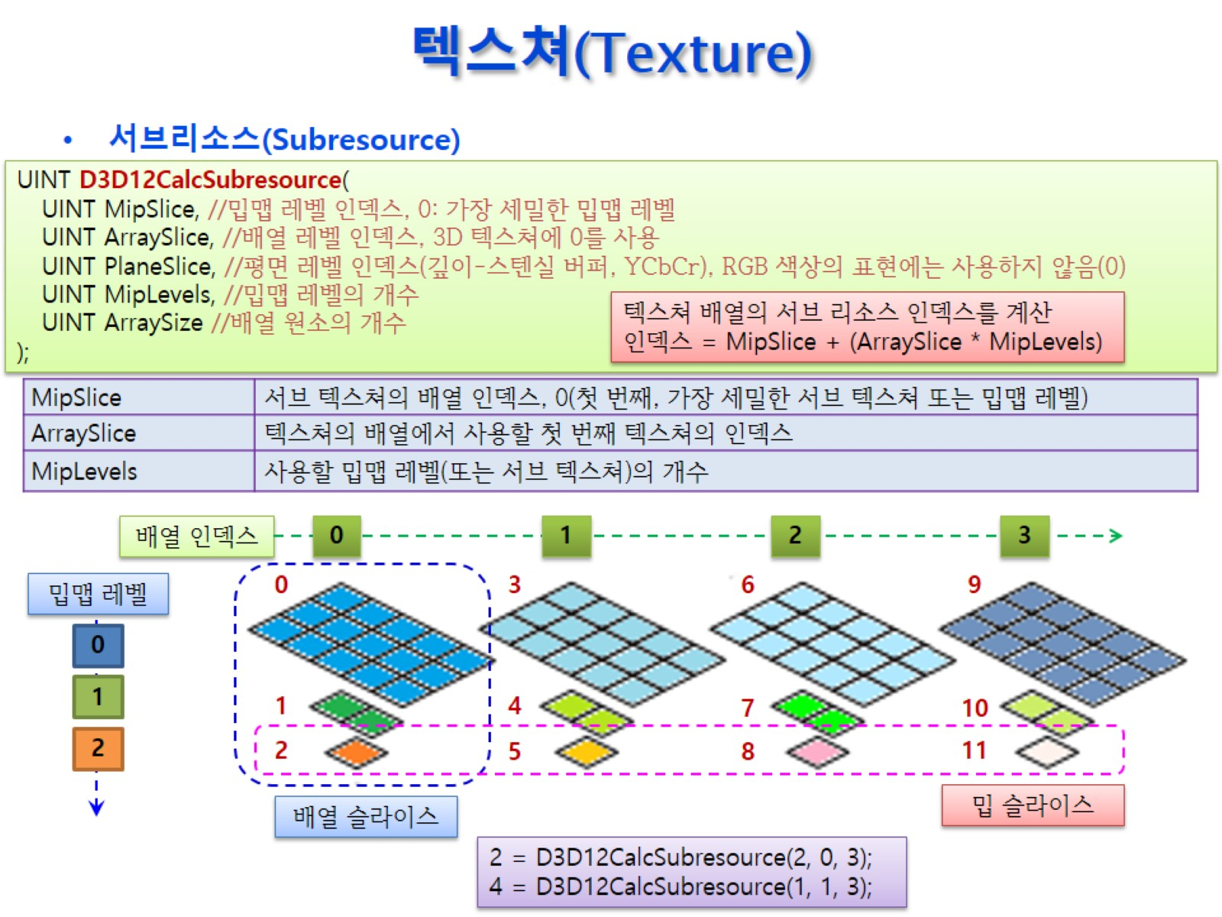
텍스쳐(Texture)

Slide 23
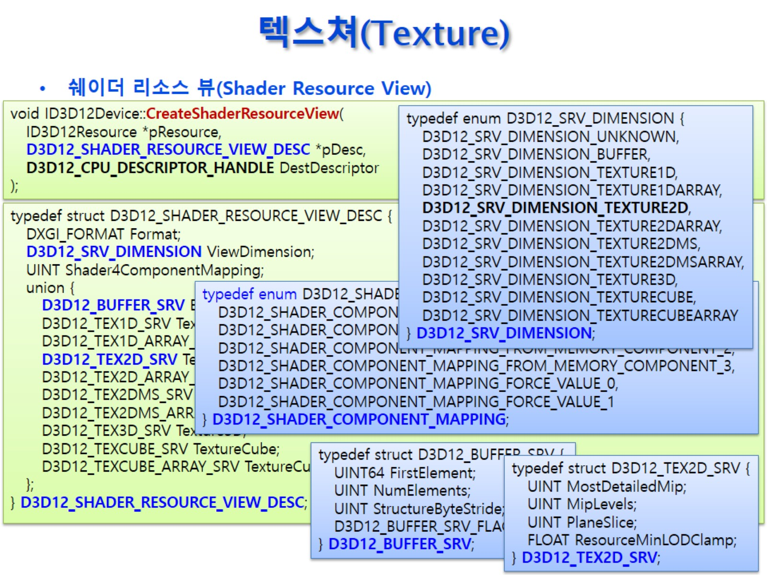
텍스쳐(Texture)

Slide 24
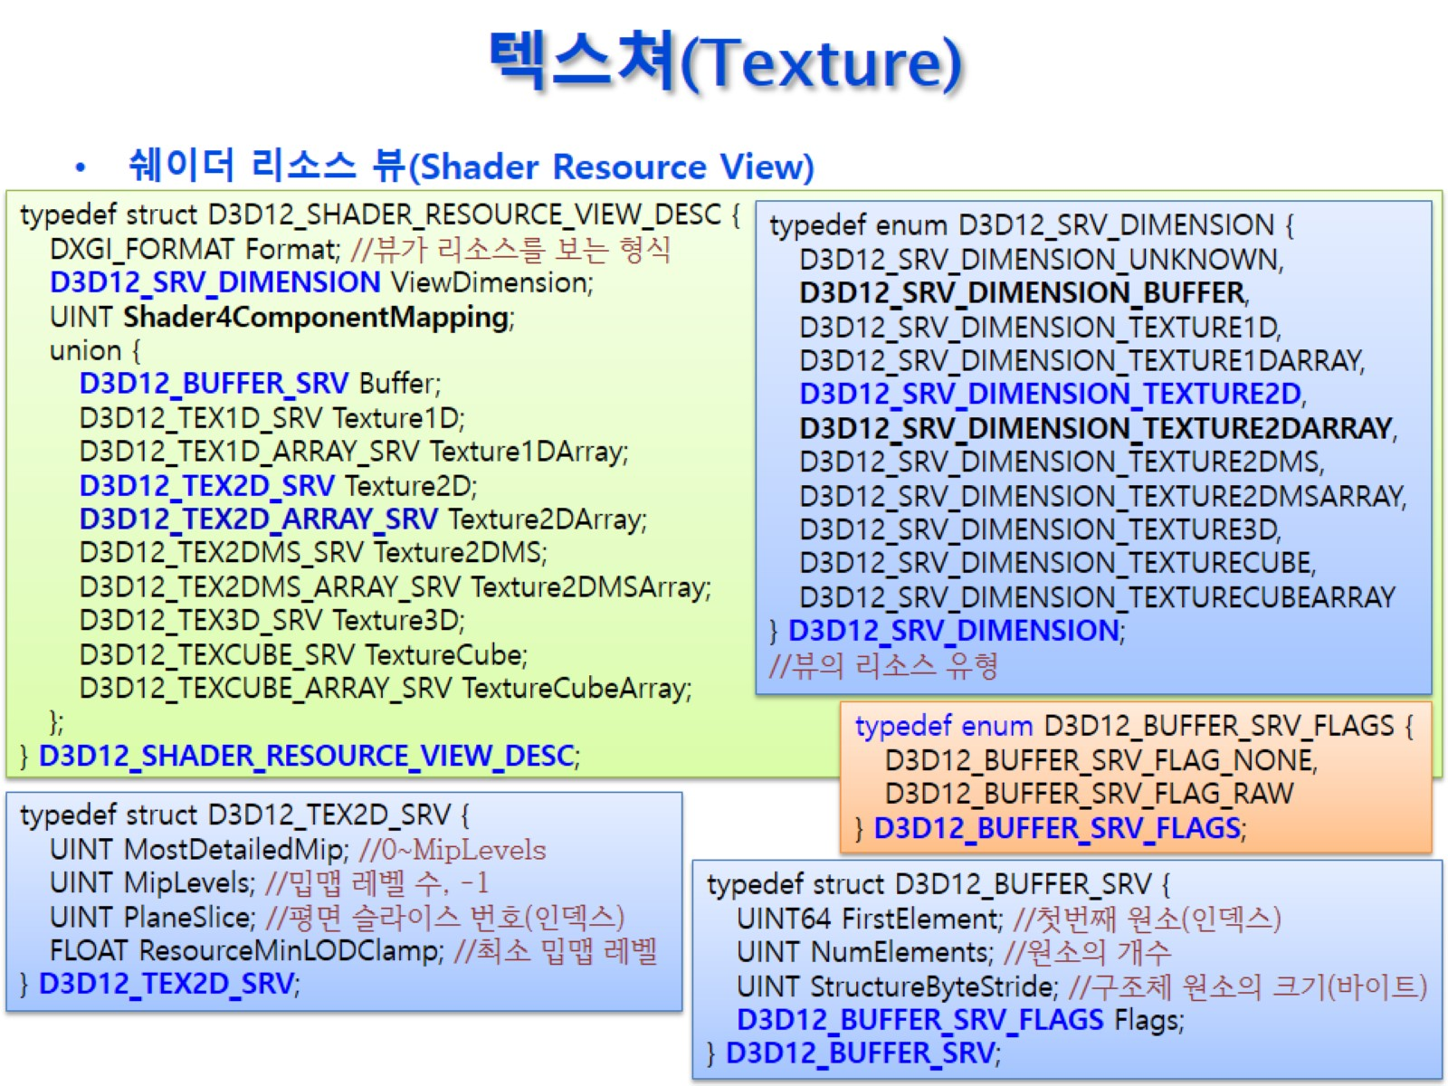
텍스쳐(Texture)

Slide 25
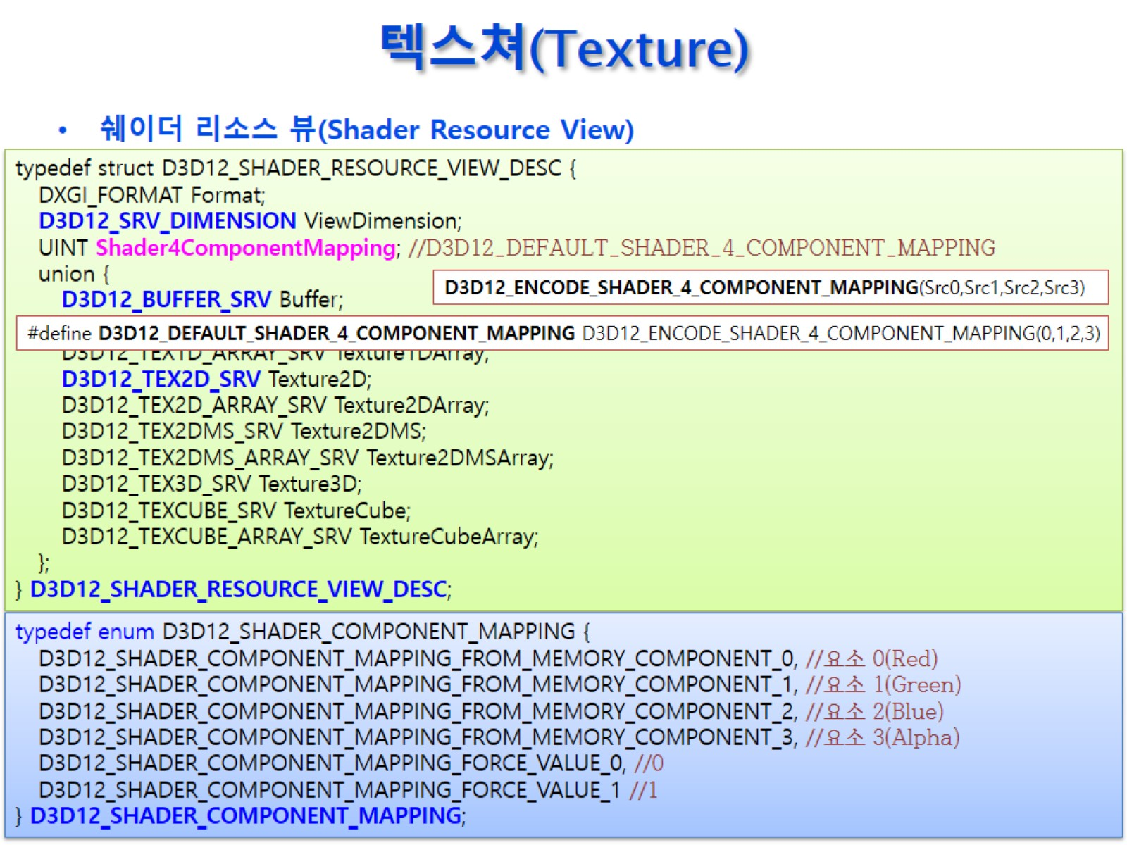
텍스쳐(Texture)

Slide 26
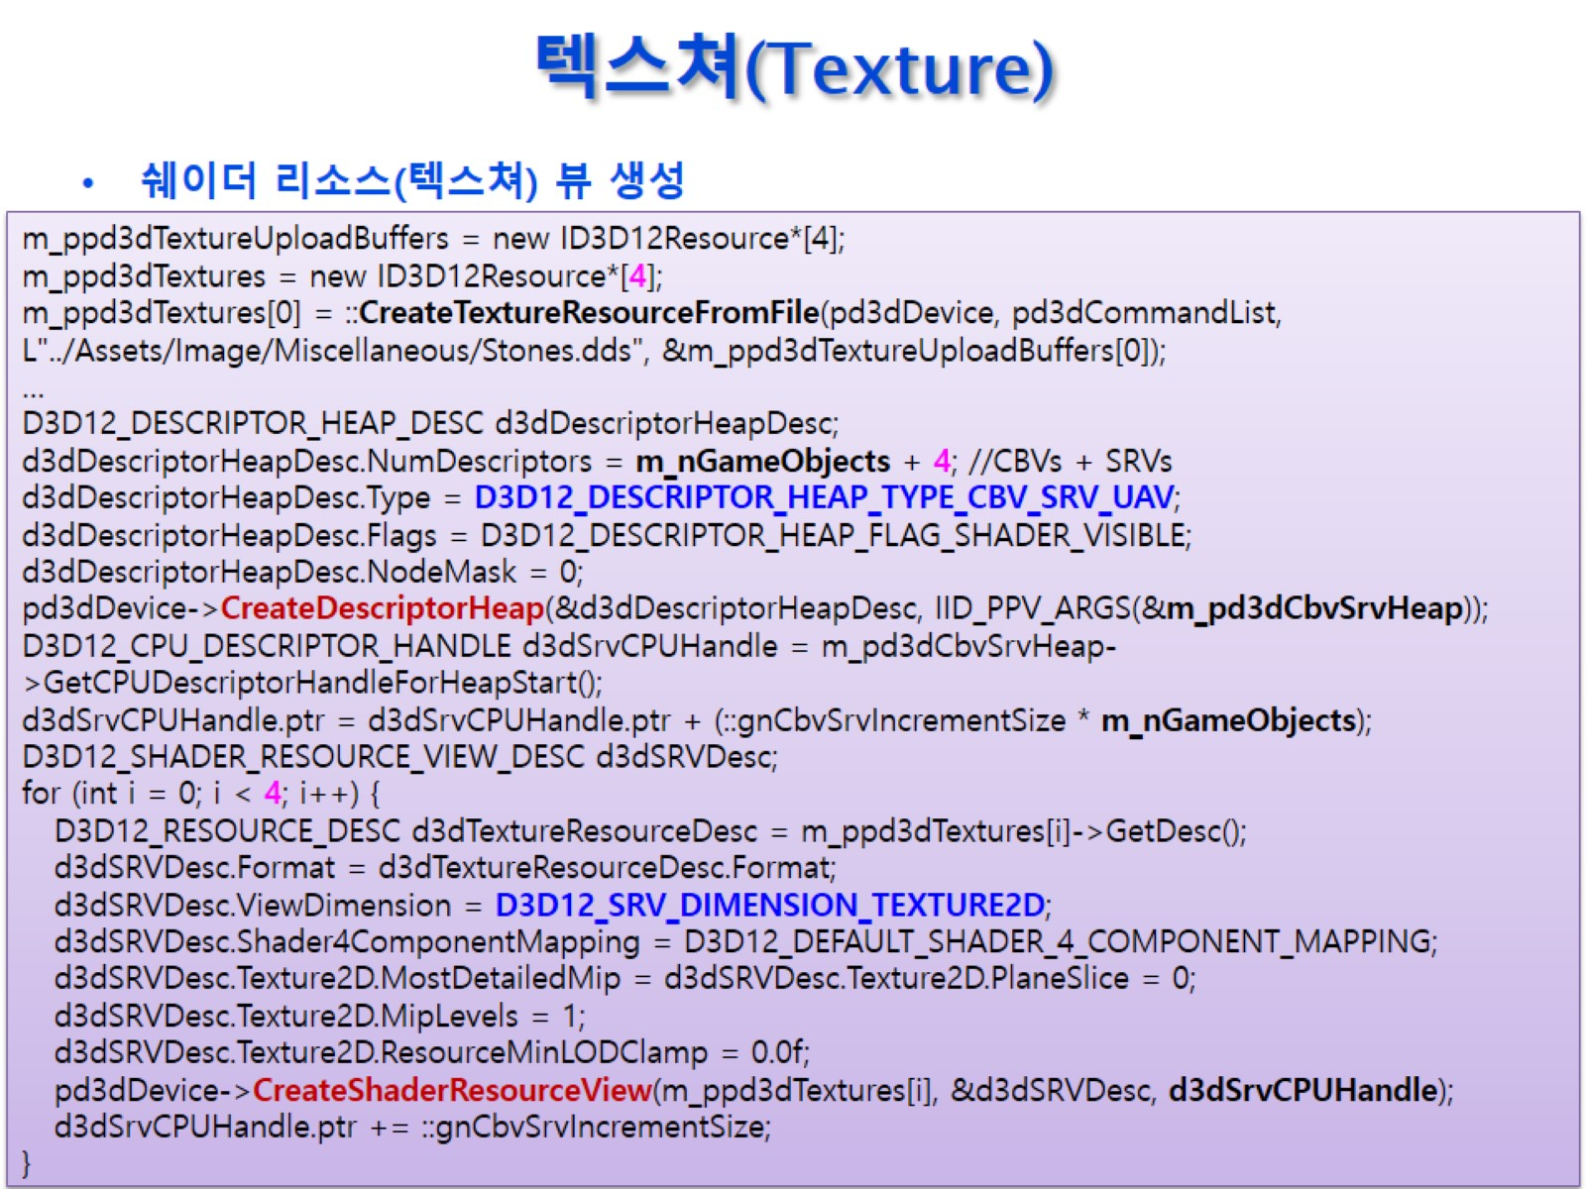
텍스쳐(Texture)

Slide 27
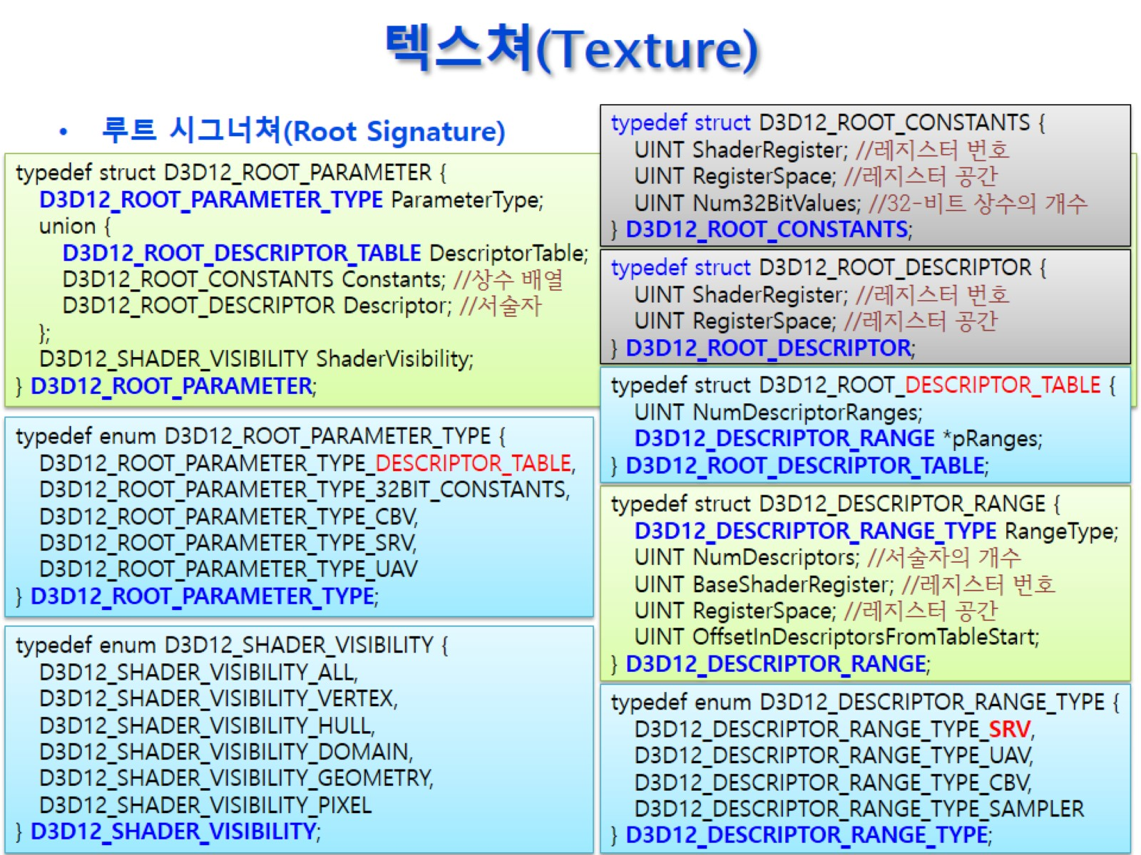
텍스쳐(Texture)

Slide 28
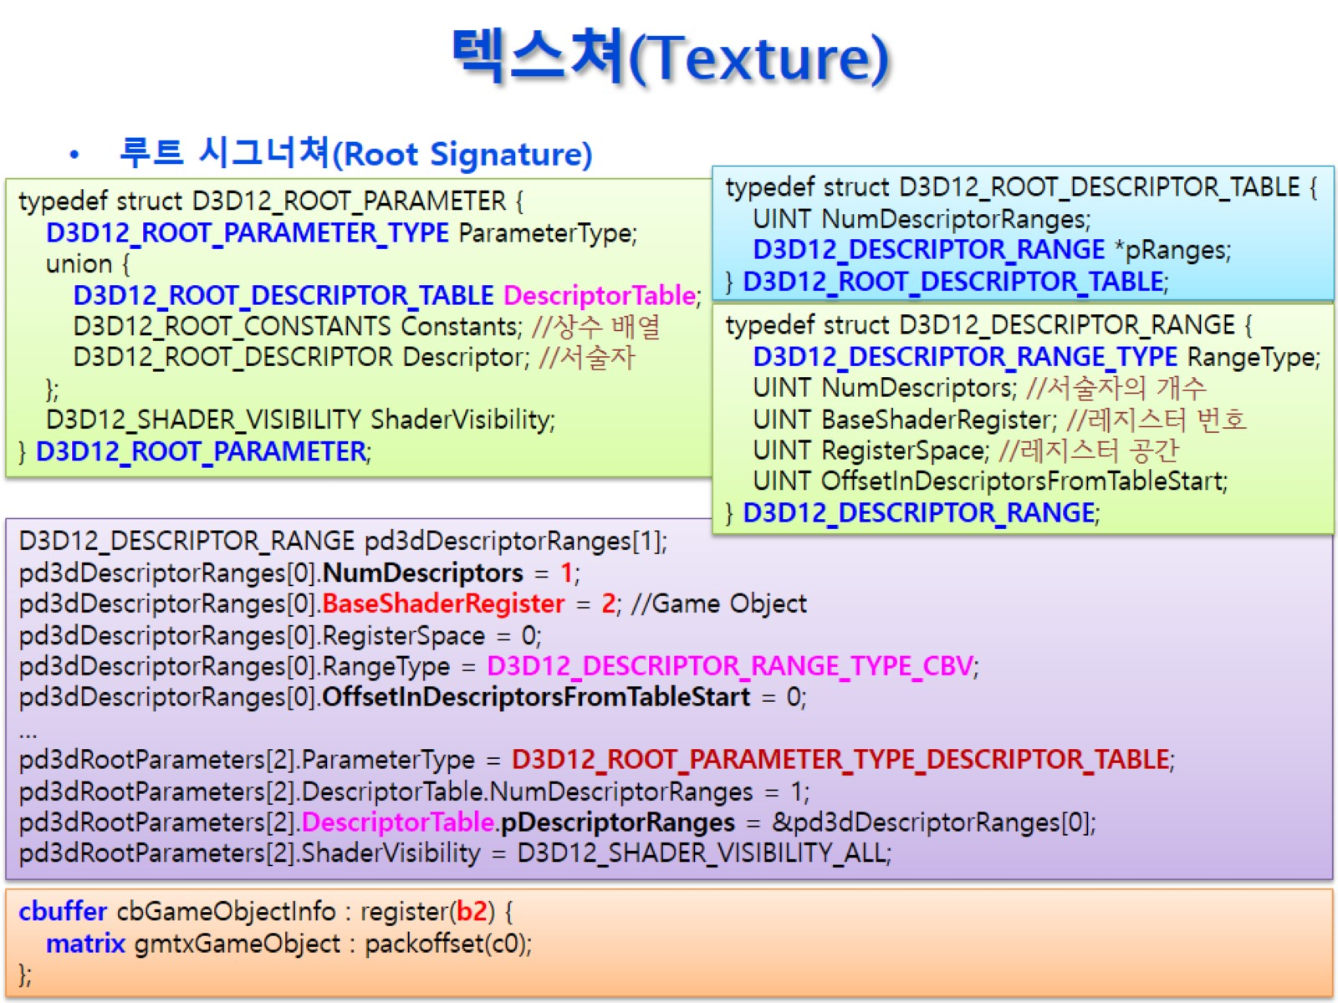
텍스쳐(Texture)

Slide 29
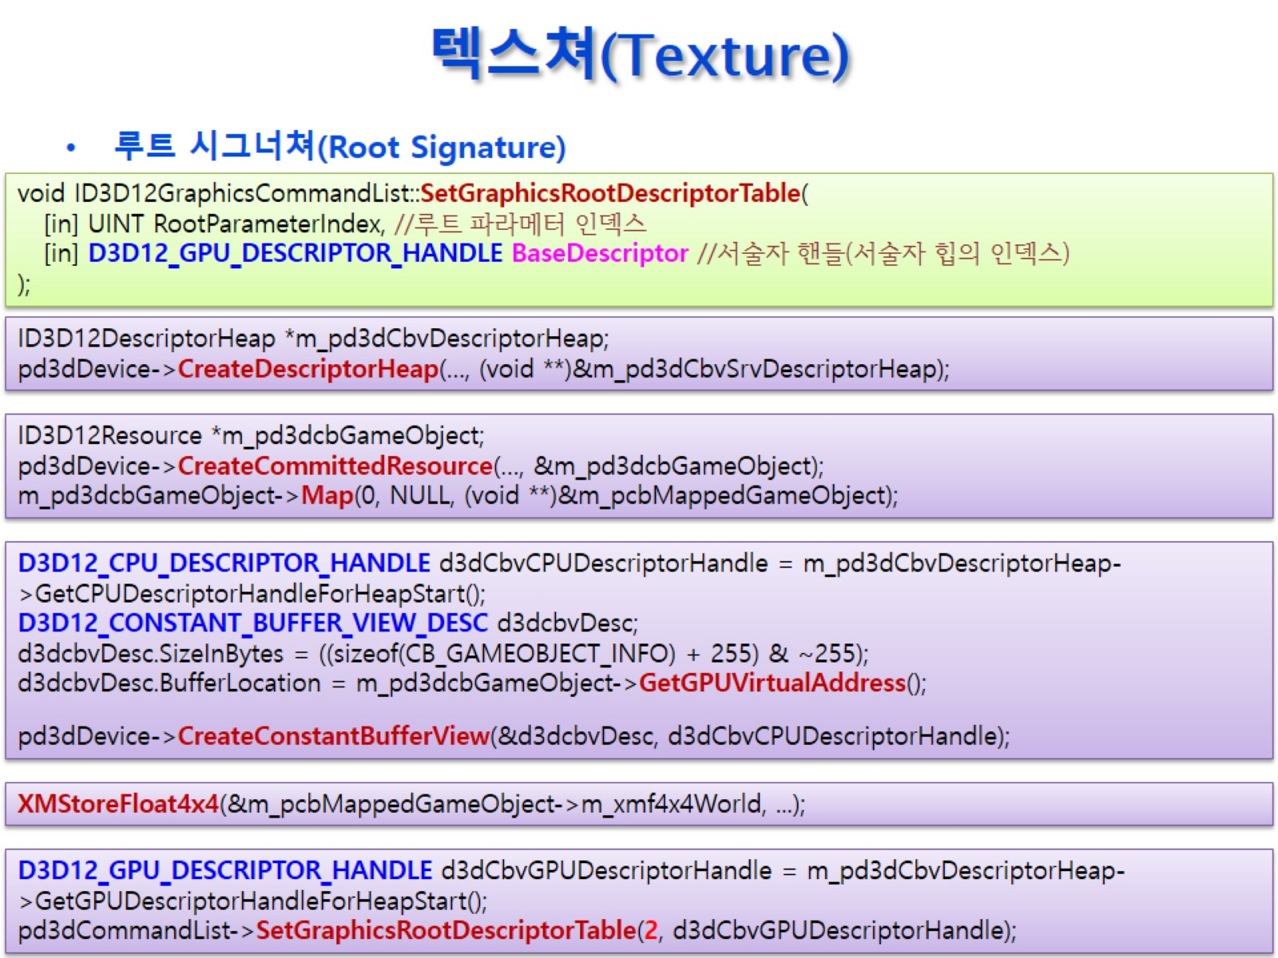
텍스쳐(Texture)

Slide 30
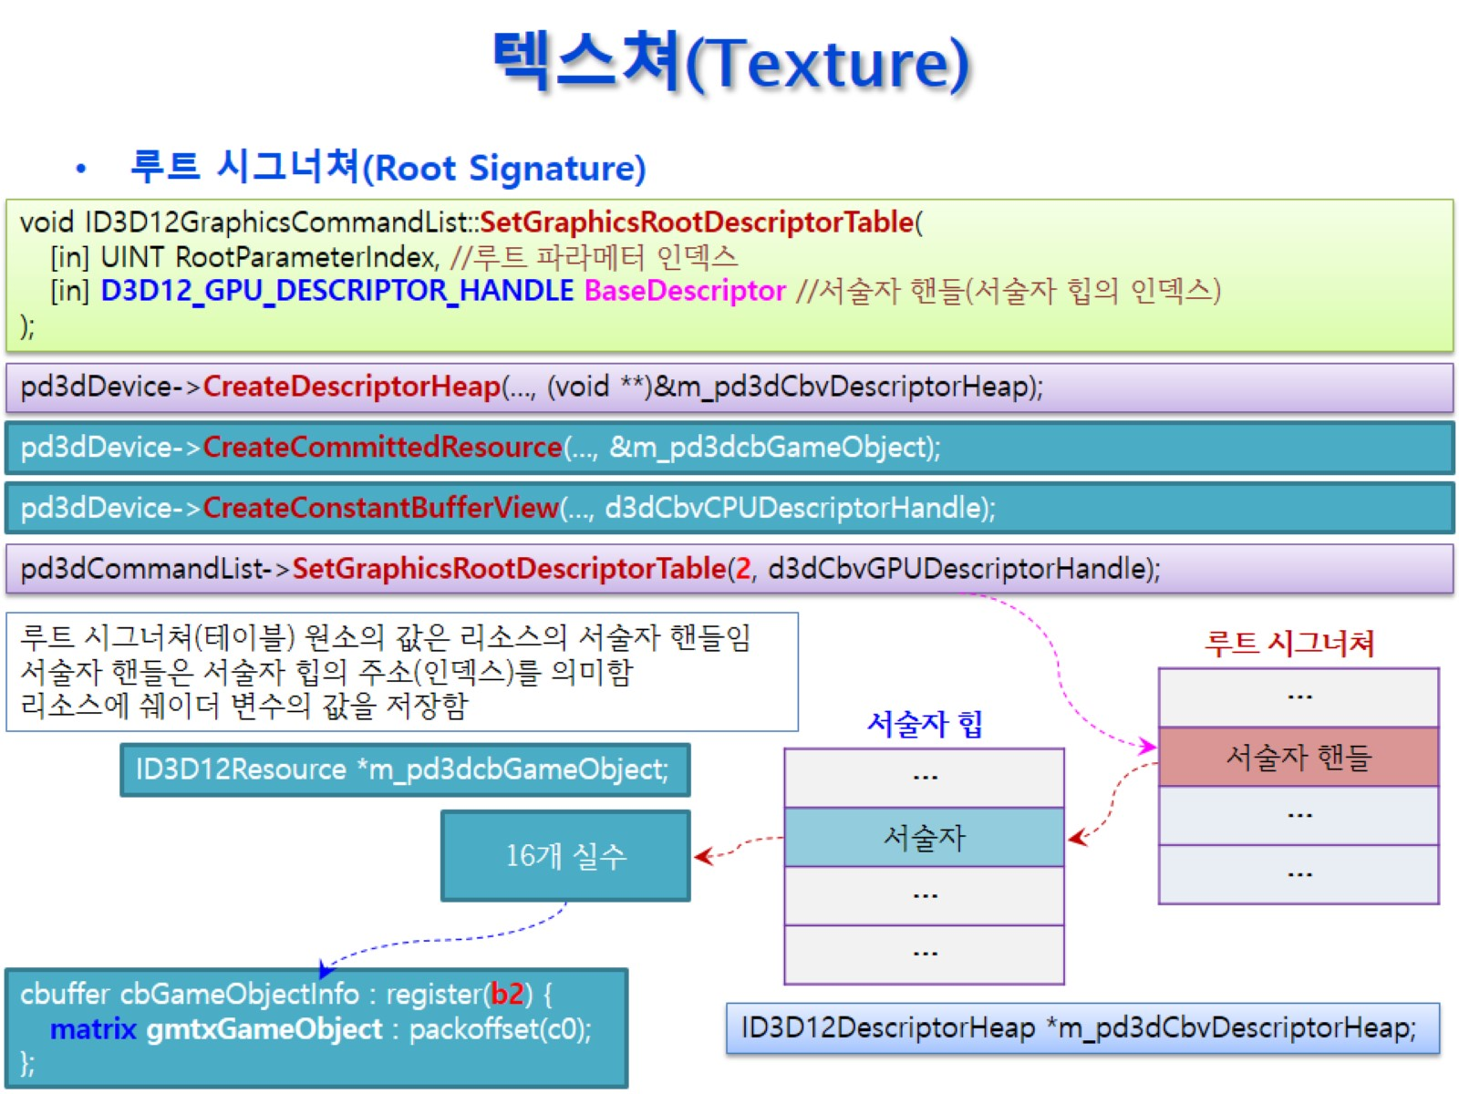
텍스쳐(Texture)

Slide 31
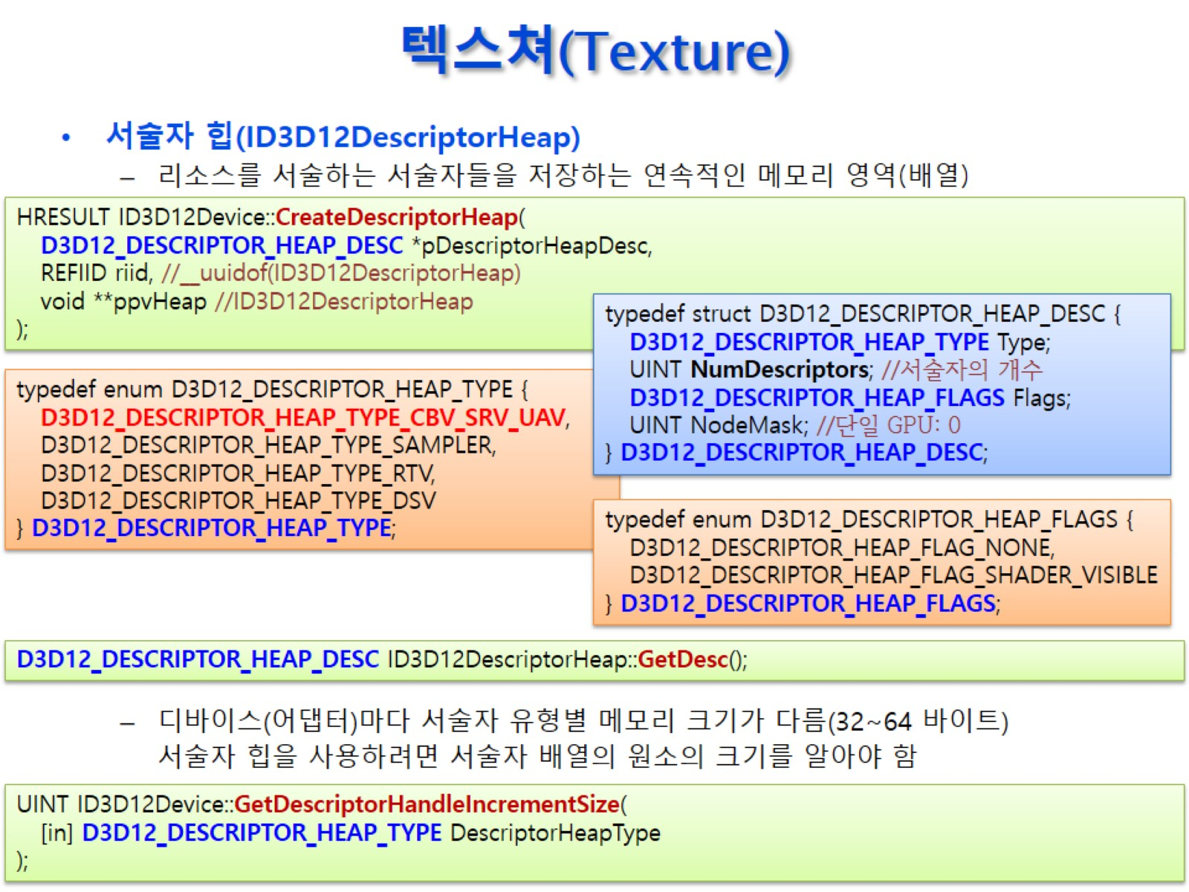
텍스쳐(Texture)

Slide 32
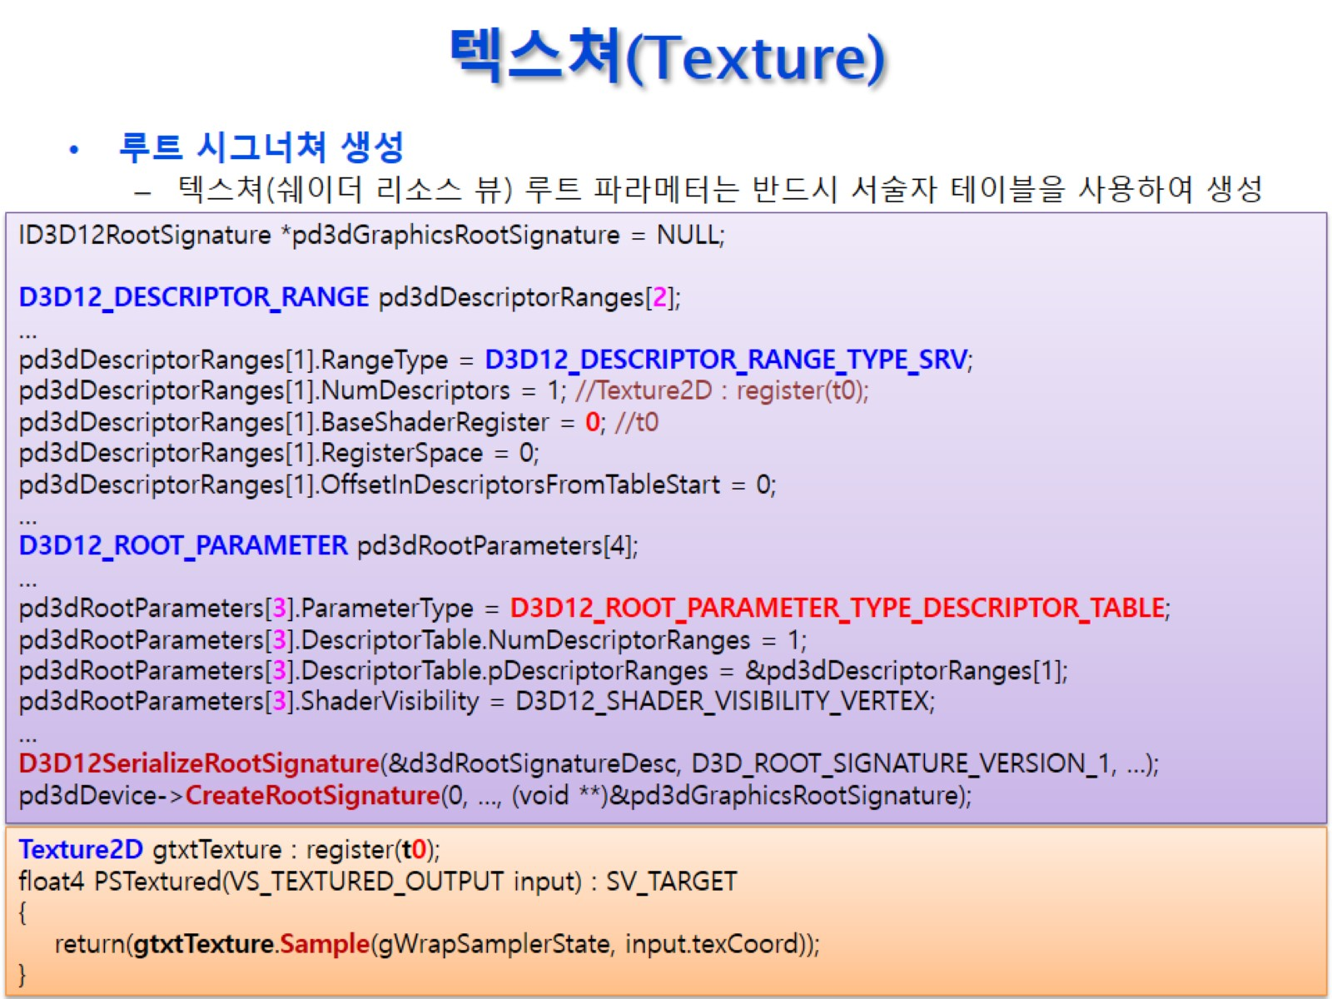
텍스쳐(Texture)

Slide 33
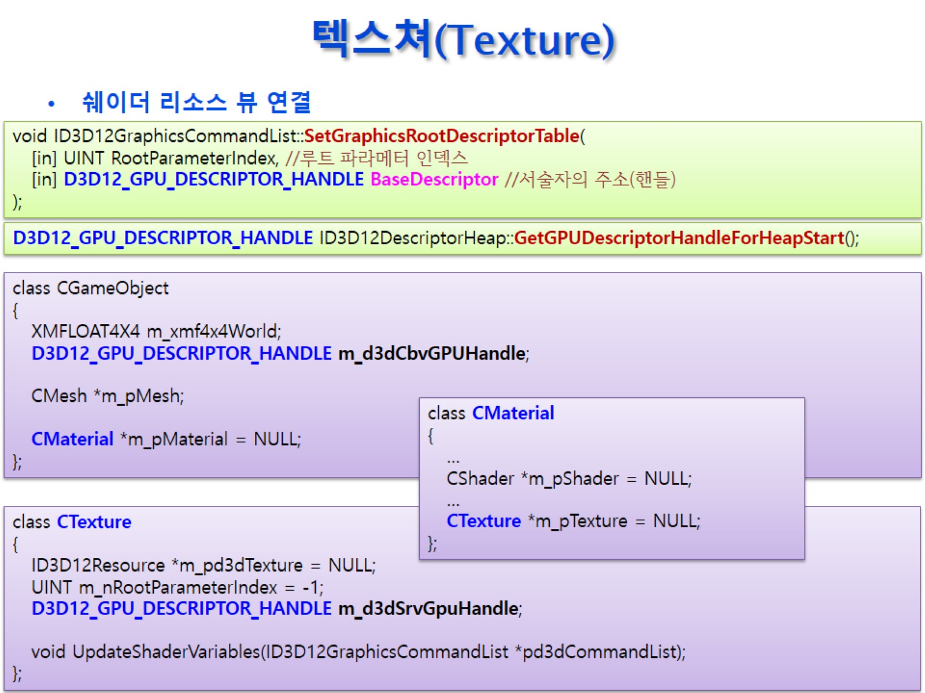
텍스쳐(Texture)

Slide 34
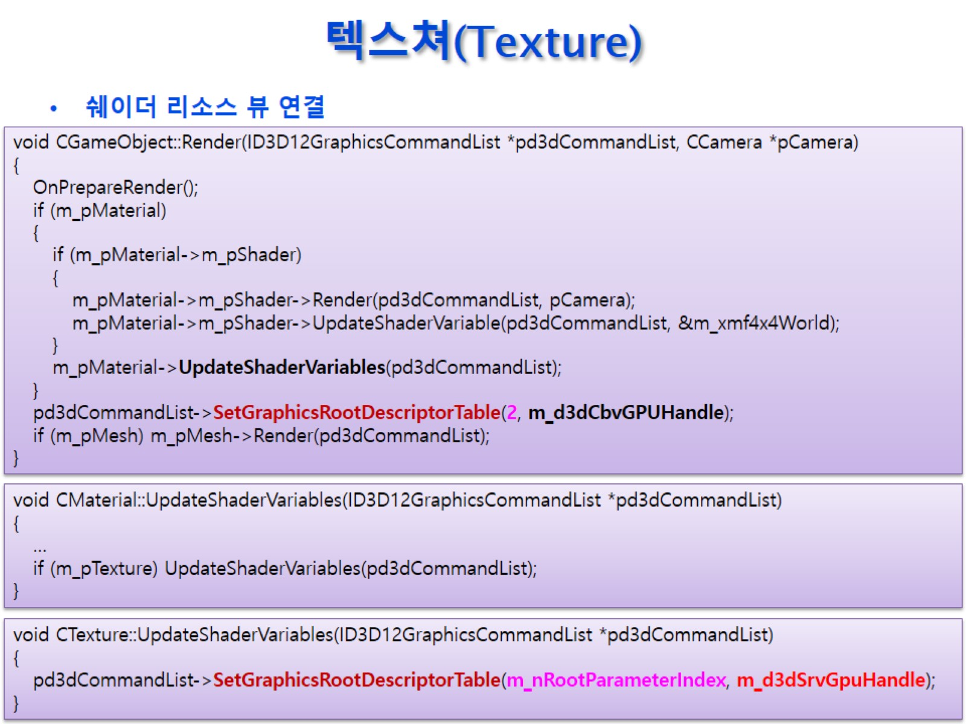
텍스쳐(Texture)

Slide 35
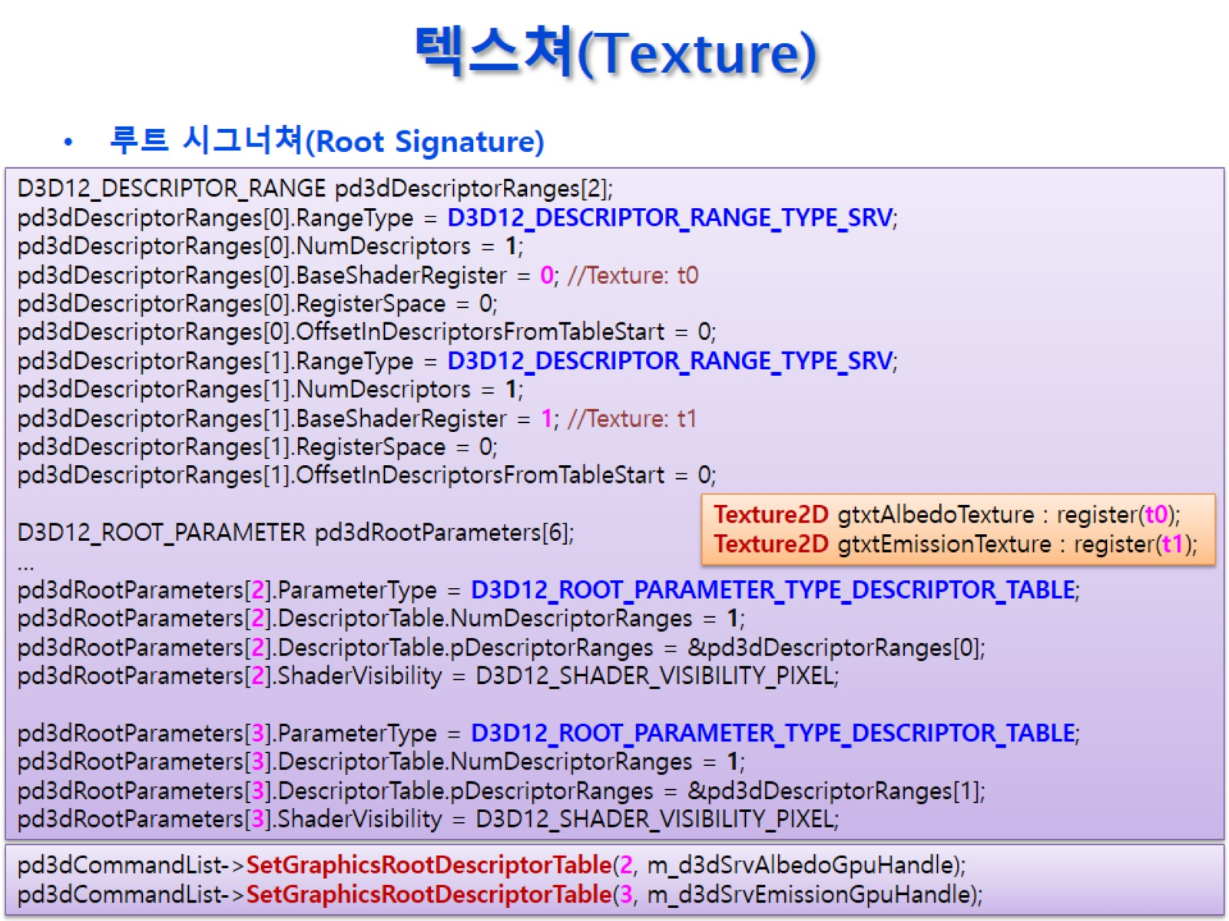
텍스쳐(Texture)

Slide 36
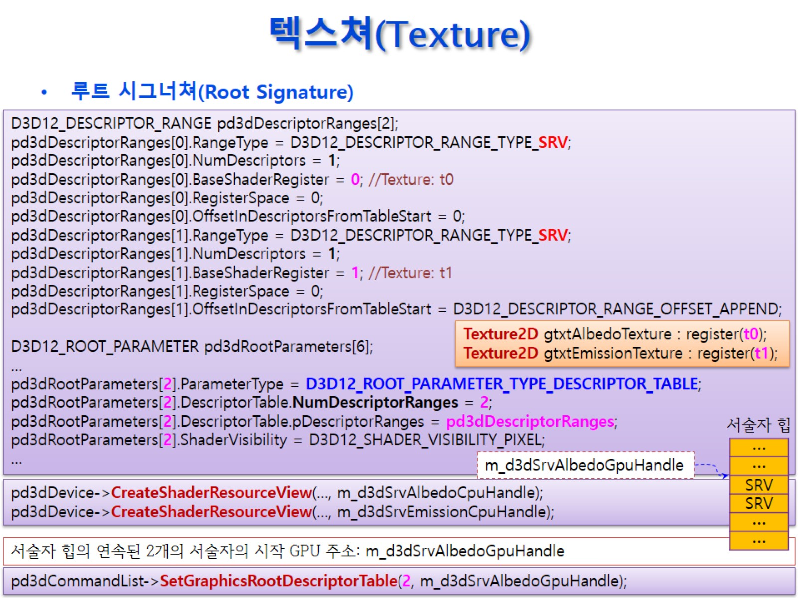
텍스쳐(Texture)

Slide 37
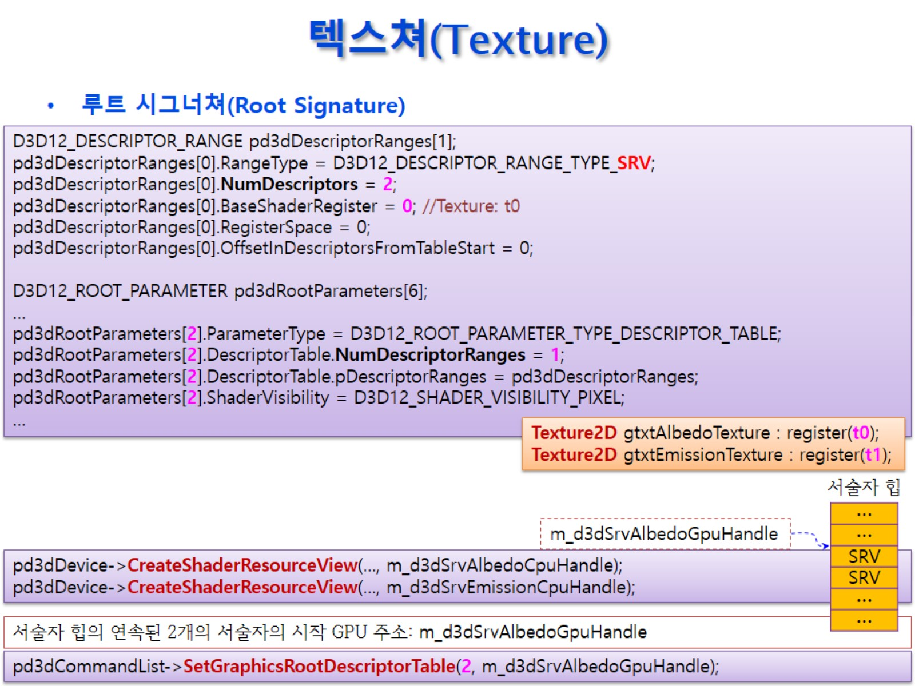
텍스쳐(Texture)

Slide 38
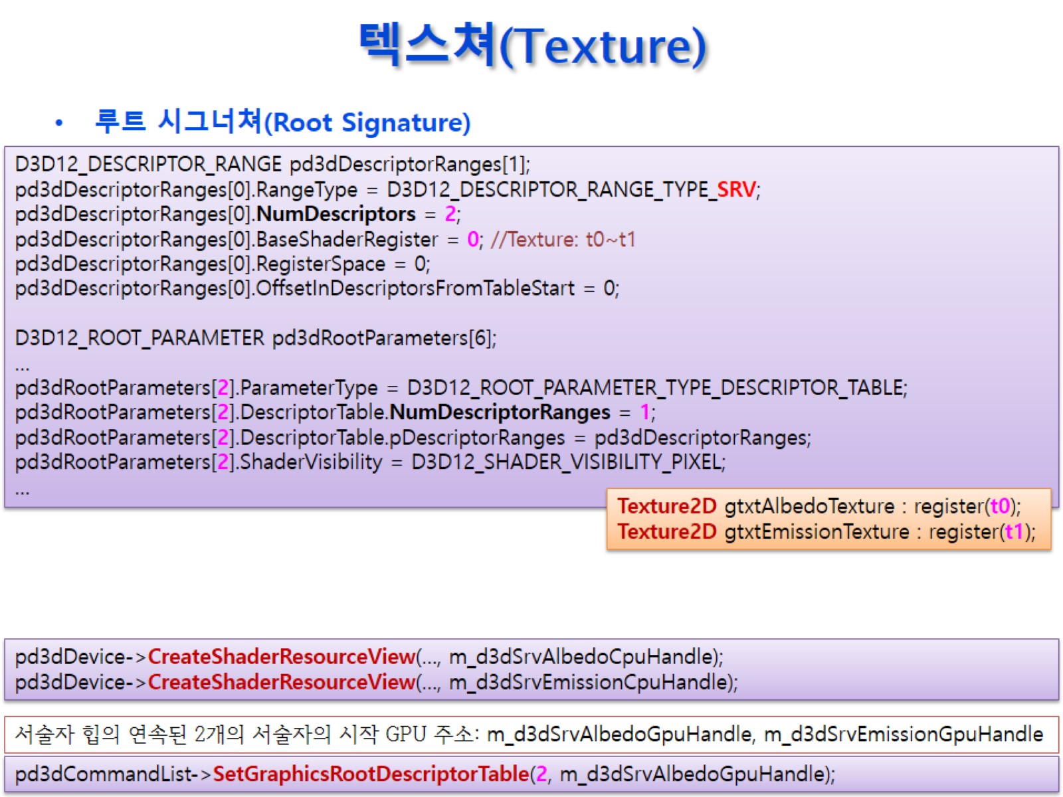
텍스쳐(Texture)

Slide 39
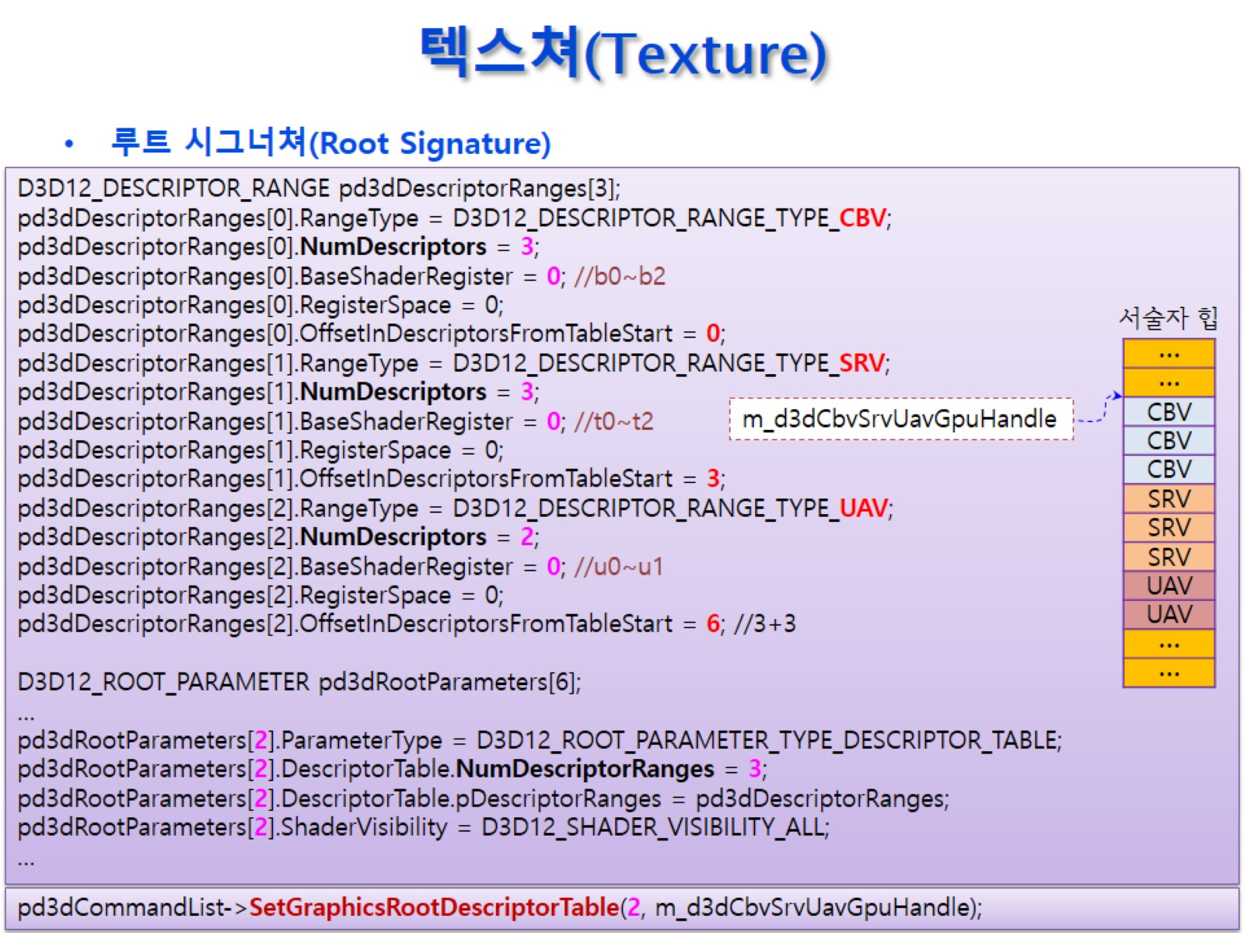
텍스쳐(Texture)

Slide 40

텍스쳐(Texture)

Slide 41
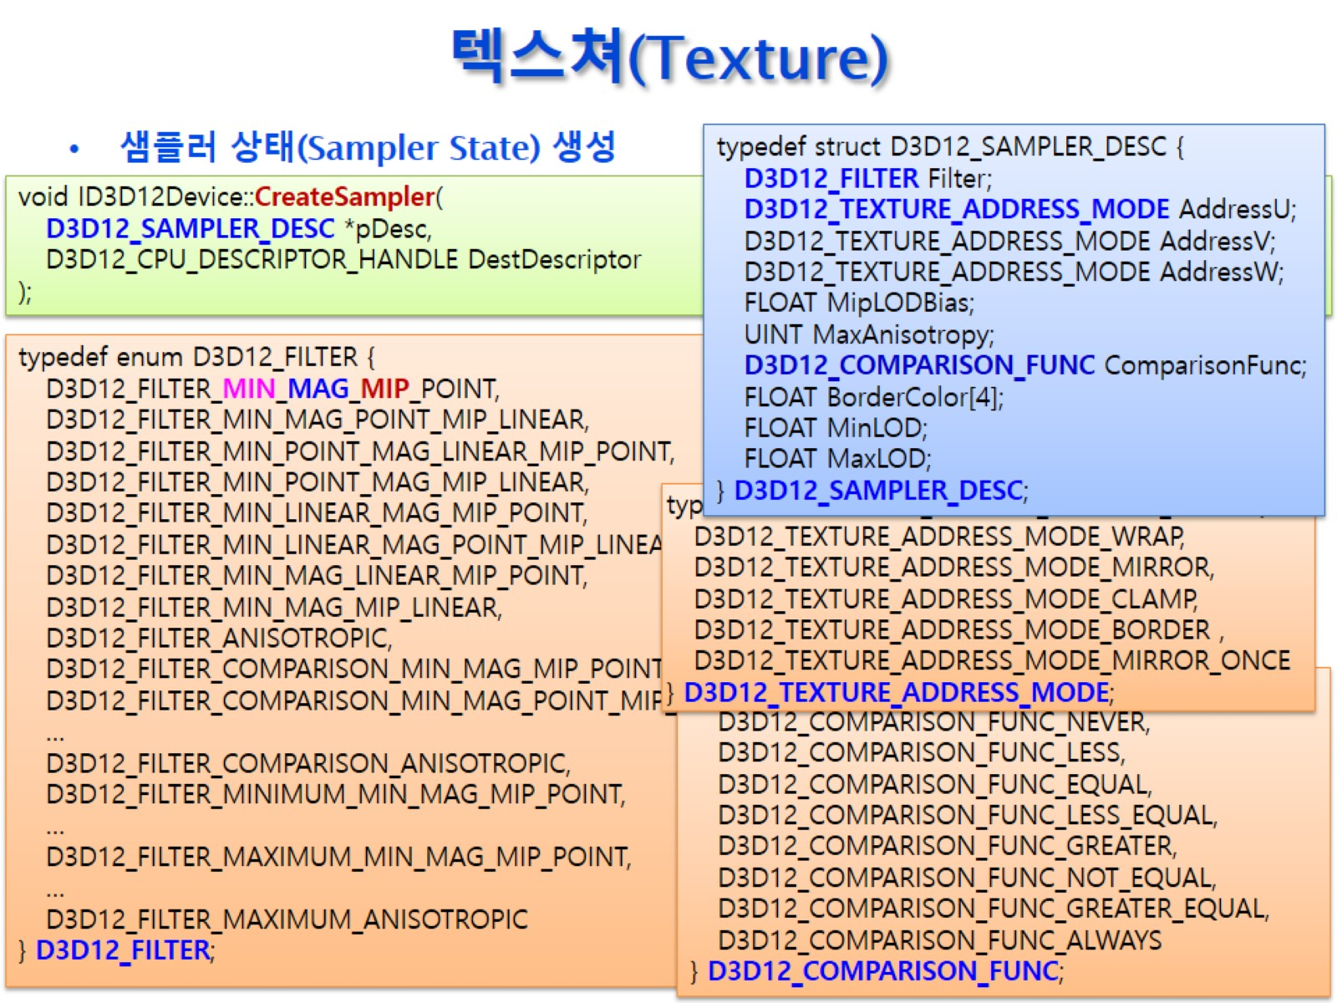
텍스쳐(Texture)

Slide 42
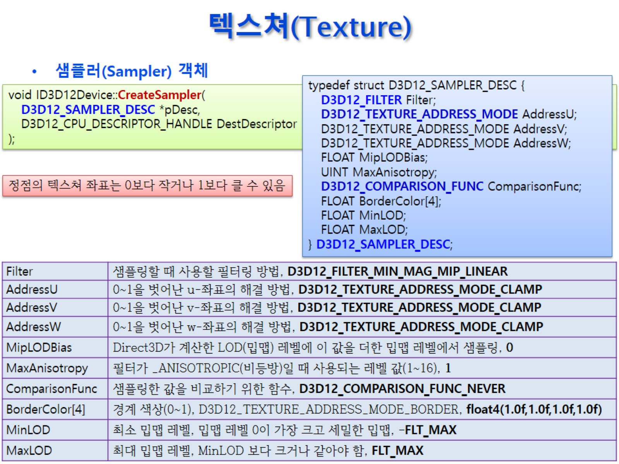
텍스쳐(Texture)

Slide 43
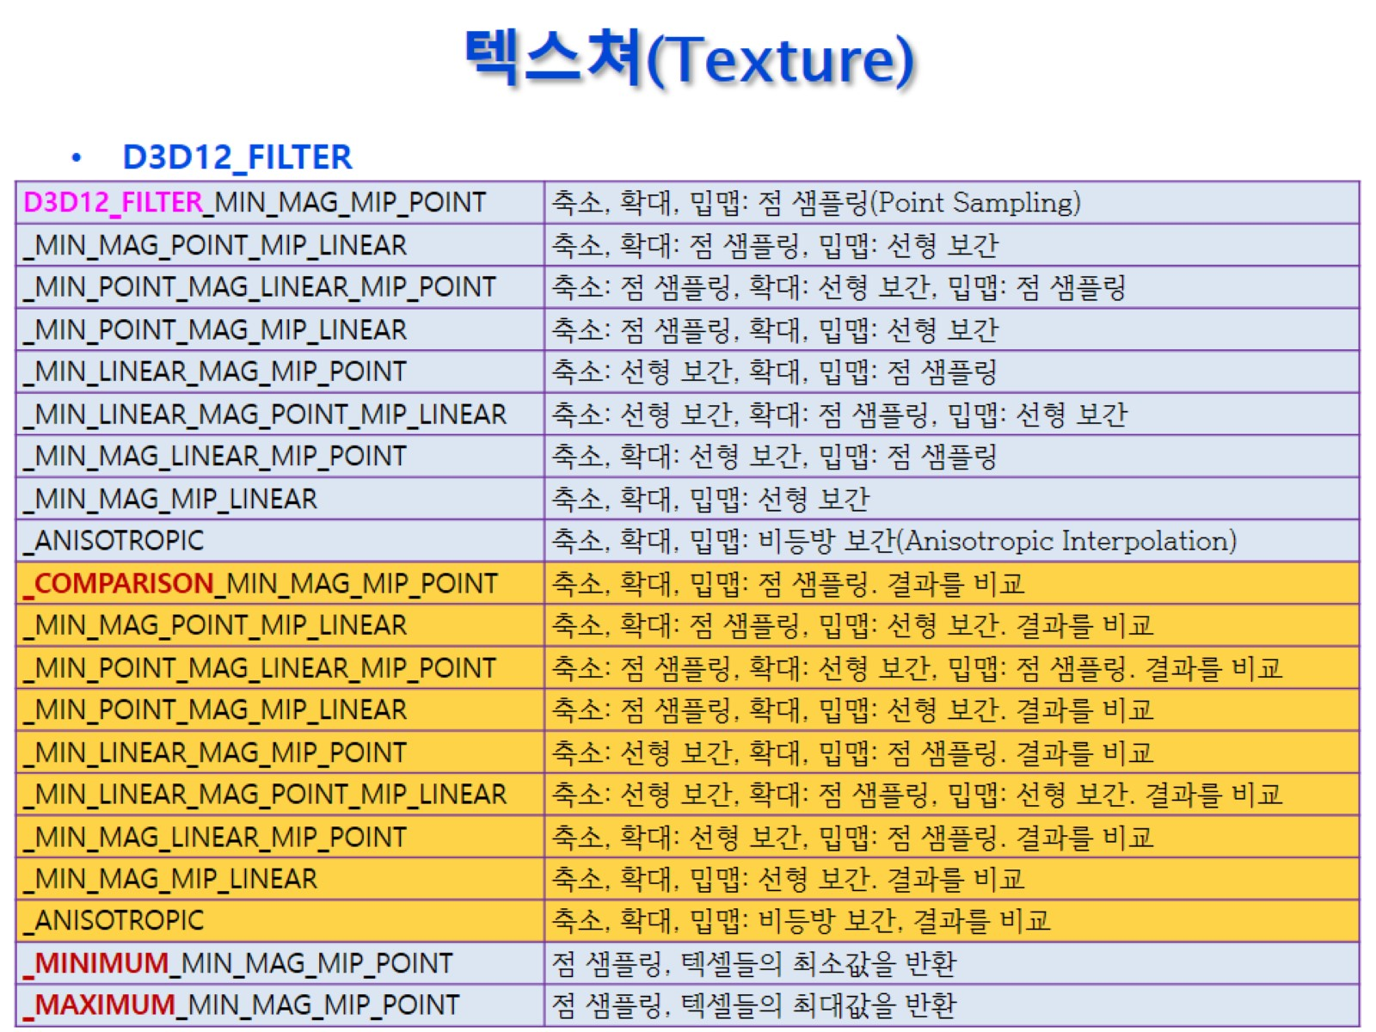
텍스쳐(Texture)

Slide 44
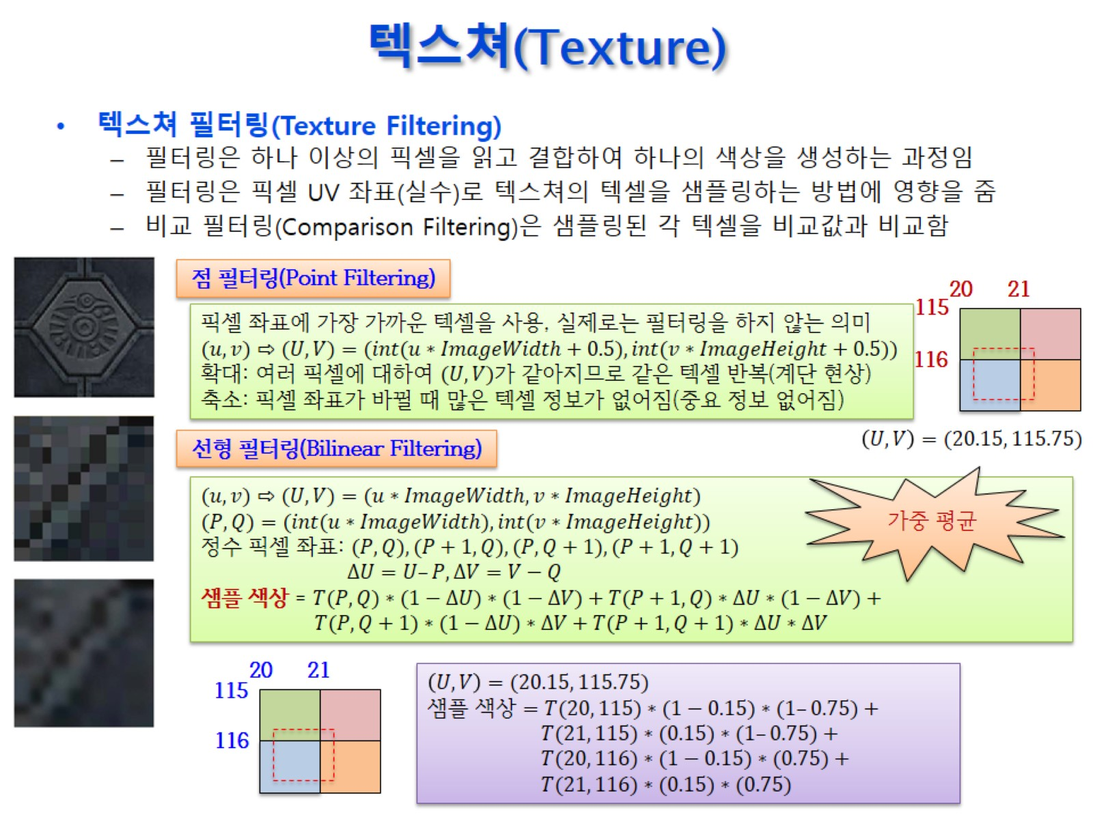
텍스쳐(Texture)

Slide 45
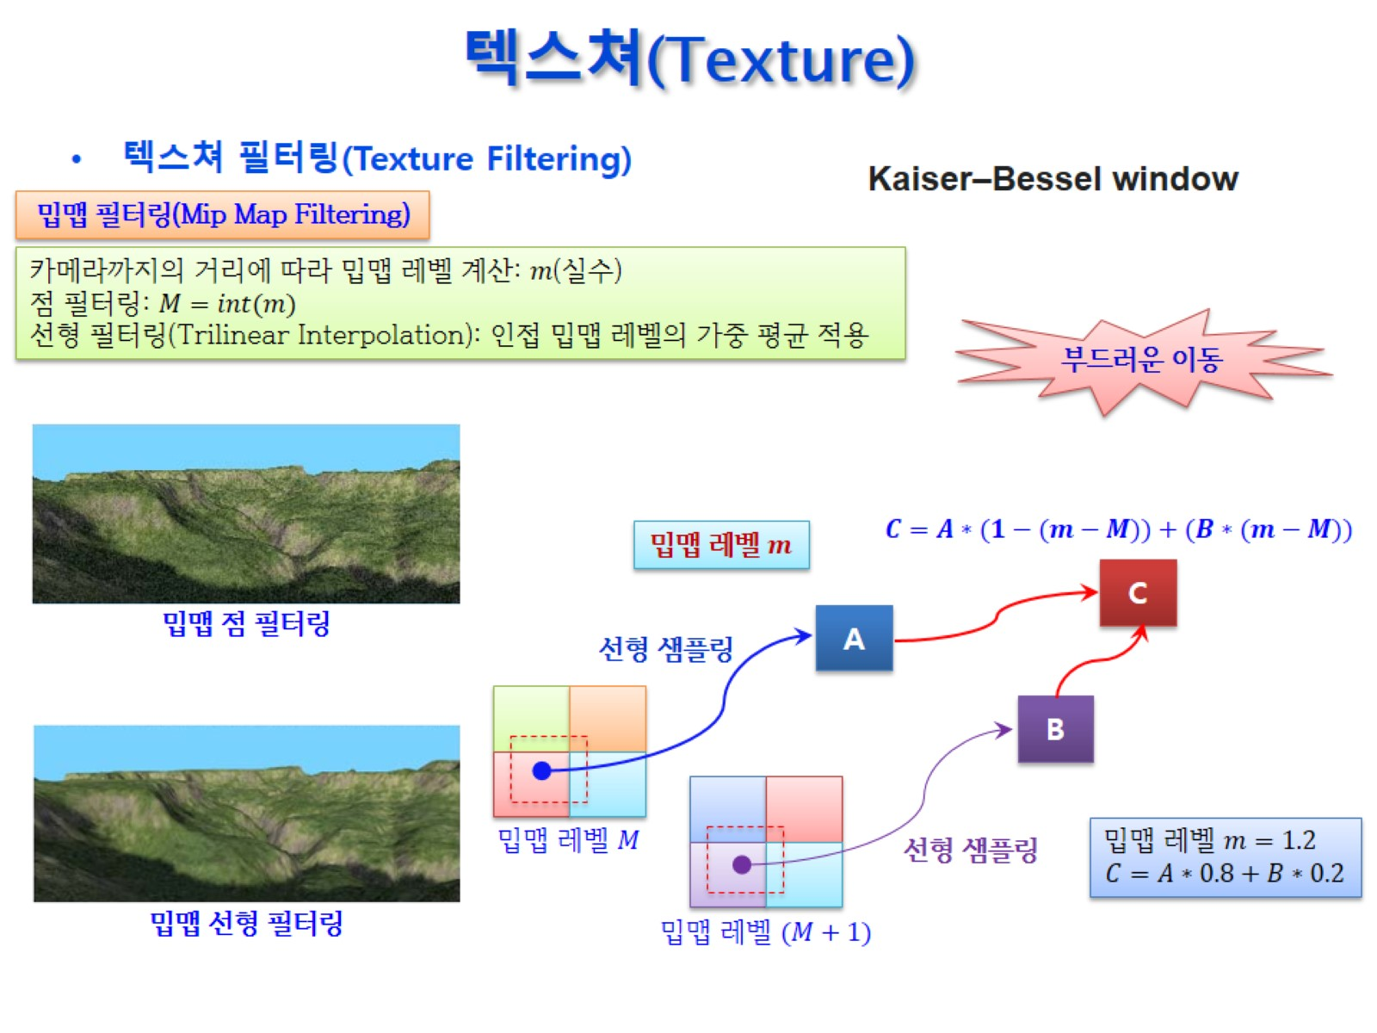
텍스쳐(Texture)

Slide 46
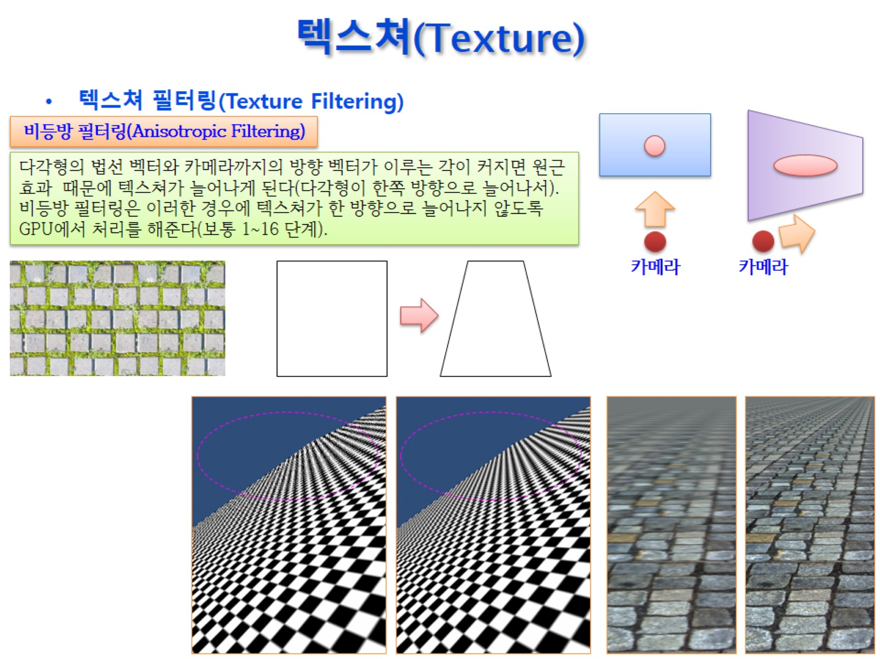
텍스쳐(Texture)

Slide 47
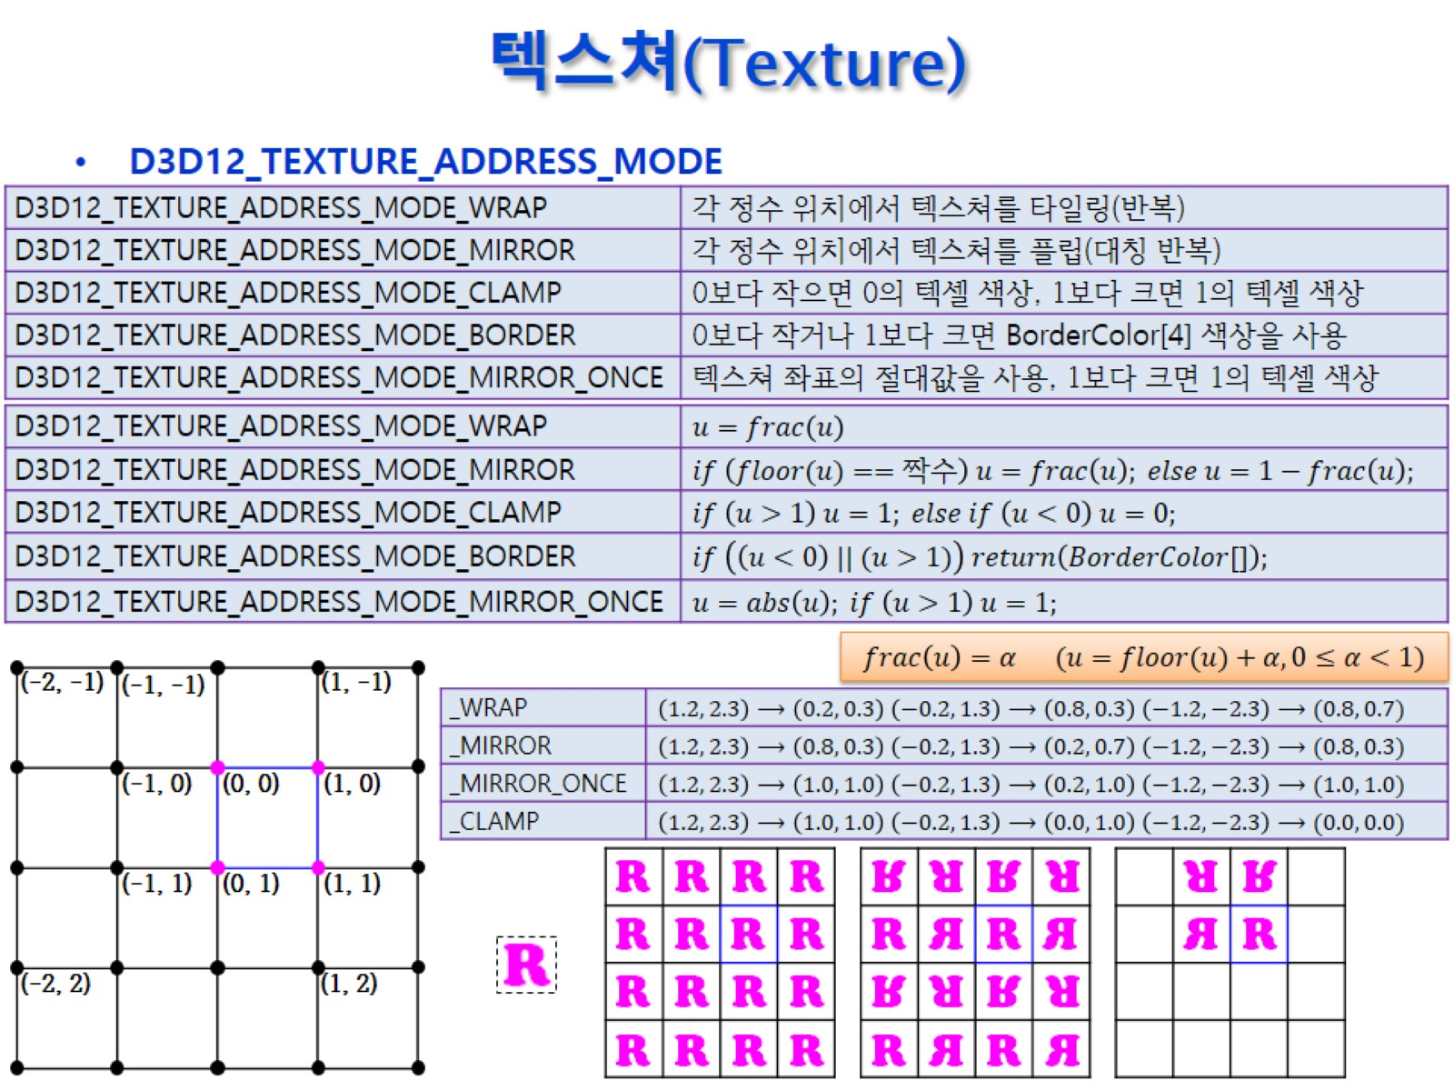
텍스쳐(Texture)

Slide 48
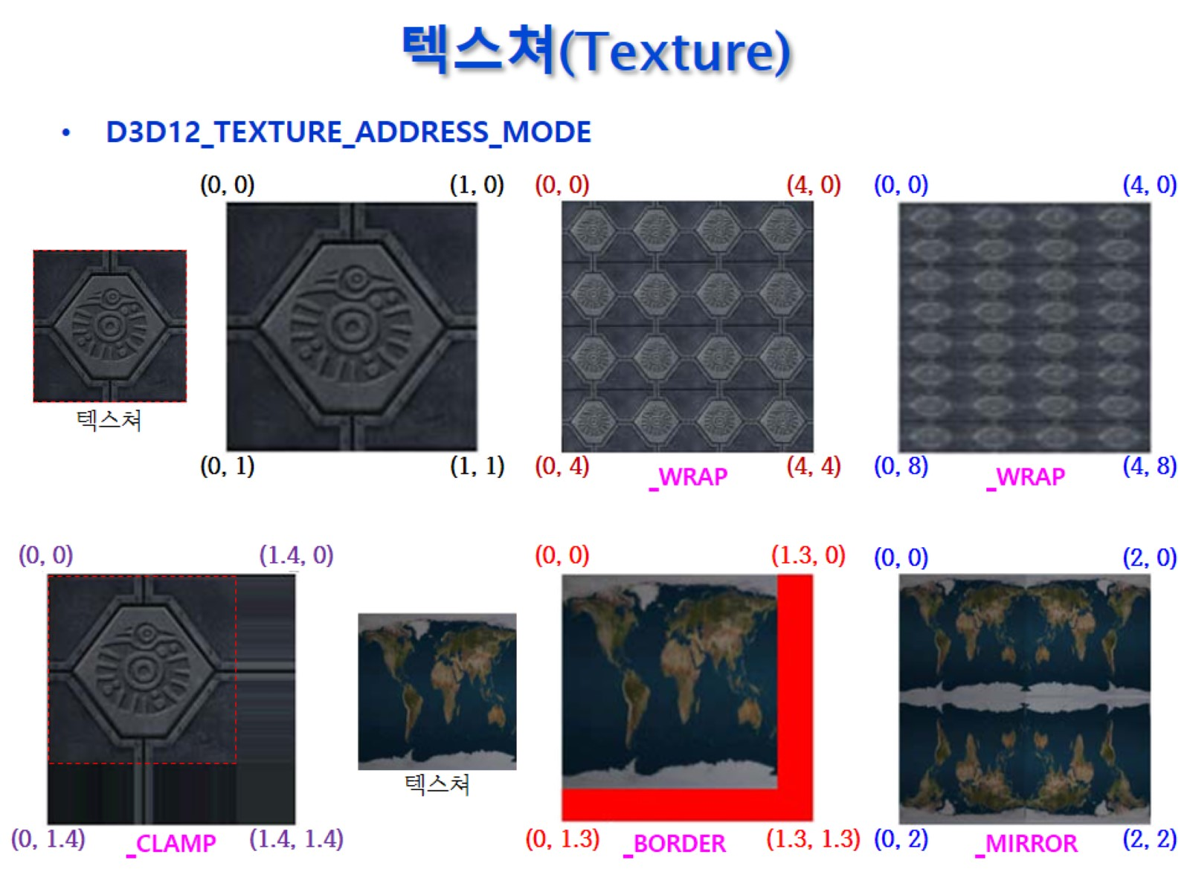
텍스쳐(Texture)

Slide 49
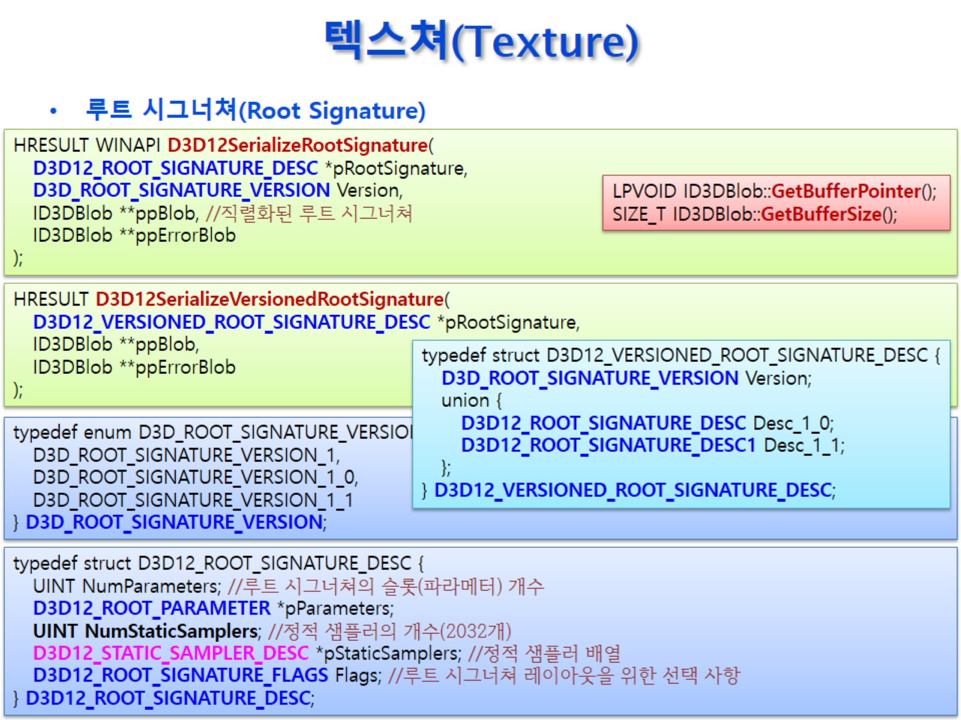
텍스쳐(Texture)

Slide 50
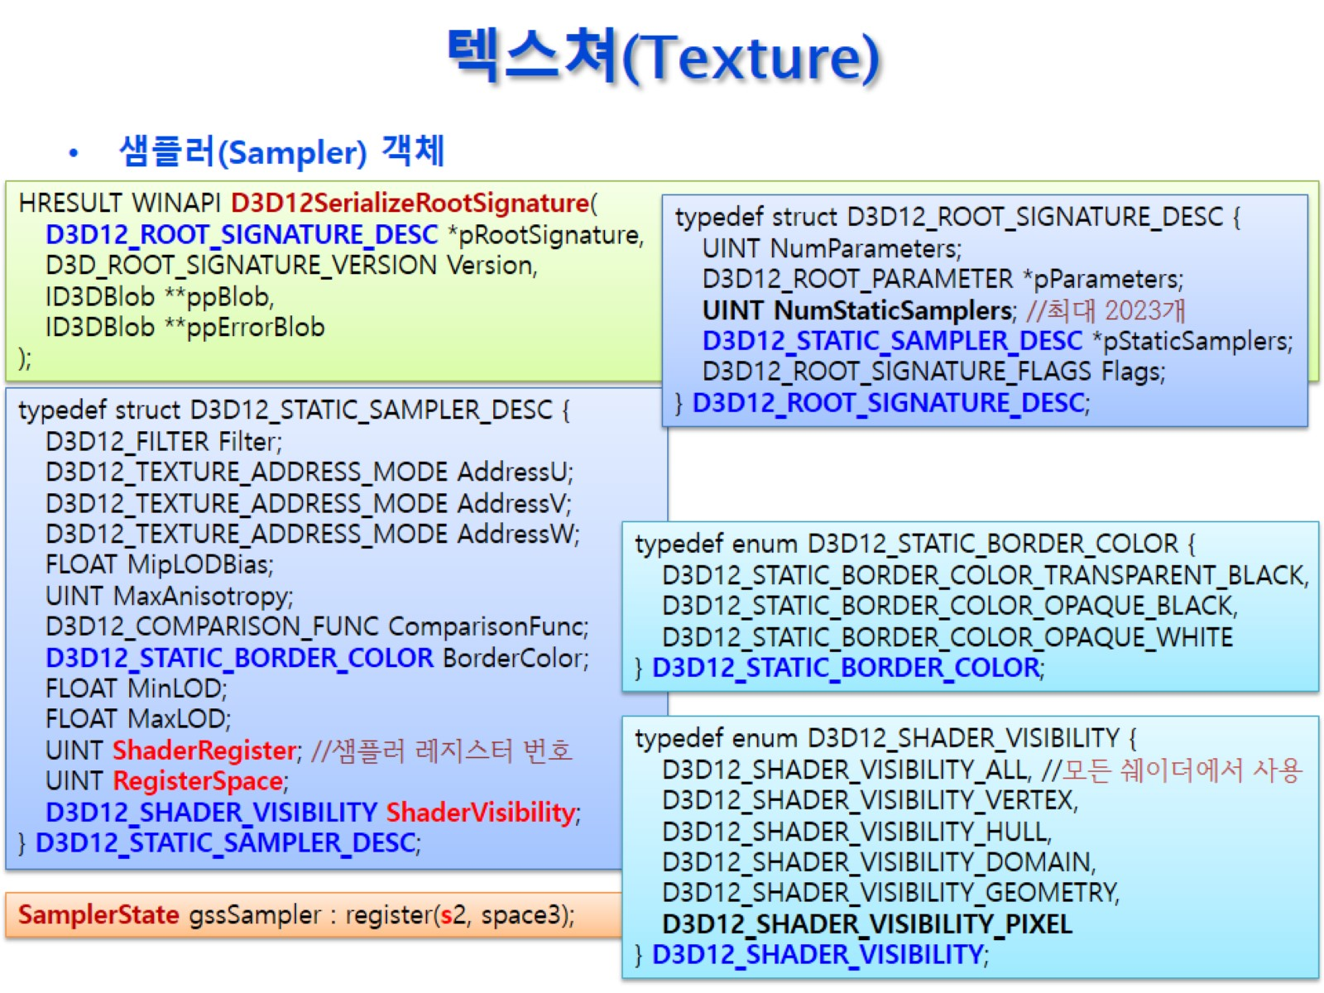
텍스쳐(Texture)

Slide 51
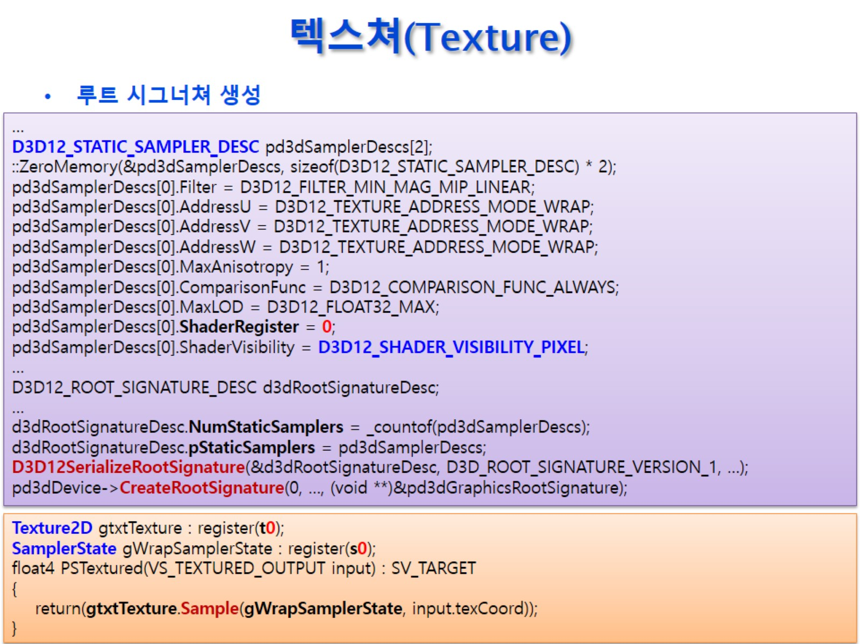
텍스쳐(Texture)

Slide 52

텍스쳐(Texture)

Slide 53

텍스쳐(Texture)

Slide 54

텍스쳐(Texture)

Slide 55

텍스쳐(Texture)

Slide 56

텍스쳐(Texture)

Slide 57

텍스쳐(Texture)

Slide 58

텍스쳐(Texture)

Slide 59

텍스쳐(Texture)

Slide 60

텍스쳐(Texture)

Slide 61

텍스쳐(Texture)

Slide 62

텍스쳐(Texture)

Slide 63

텍스쳐(Texture)

Slide 64

텍스쳐(Texture)

Slide 65

텍스쳐(Texture)

Slide 66

텍스쳐(Texture)

Slide 67

텍스쳐(Texture)

Slide 68

텍스쳐(Texture)

Slide 69

텍스쳐(Texture)

Slide 70

텍스쳐(Texture)

Slide 71

텍스쳐(Texture)

Slide 72

텍스쳐(Texture)

Slide 73

텍스쳐(Texture)

Slide 74

텍스쳐(Texture)

Slide 75

텍스쳐(Texture)

Slide 76

텍스쳐(Texture)

Slide 77

텍스쳐(Texture)

Slide 78

텍스쳐(Texture)

Slide 79

텍스쳐(Texture)

Slide 80

텍스쳐(Texture)

Slide 81

텍스쳐(Texture)

Slide 82

텍스쳐(Texture)

Slide 83

텍스쳐(Texture)

Slide 84

텍스쳐(Texture)

Slide 85

텍스쳐(Texture)

Slide 86

텍스쳐(Texture)

